Slide 1
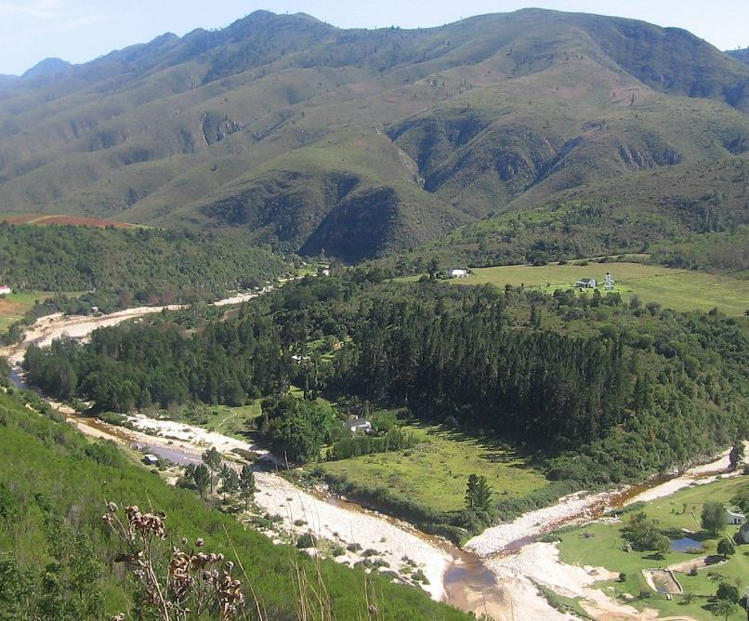

Groundwater
1. Prioritisation of GRUs
Notes:
Erik and team to present the methodology used for scenario evaluation

Slide 2
Groundwater resource units
Unit of analysis for:
  Status quo assessment: recharge, discharge, groundwater use, trend analysis
  Groundwater balance model, present status
  Impact of classification scenarios on groundwater
  Prioritisation of areas
  Determination of RQOs
Hydraulic boundaries for groundwater

Slide 3
Groundwater resource units
Delineation took the following into consideration:
Surface water topographical divides on a quaternary and secondary level
Geological structures (i.e. faults, hydro-stratigraphy, dykes, lithological contact zones)
Recharge zones
Discharge zones
River systems
Groundwater use
Groundwater management (size and extent of units)

Slide 4
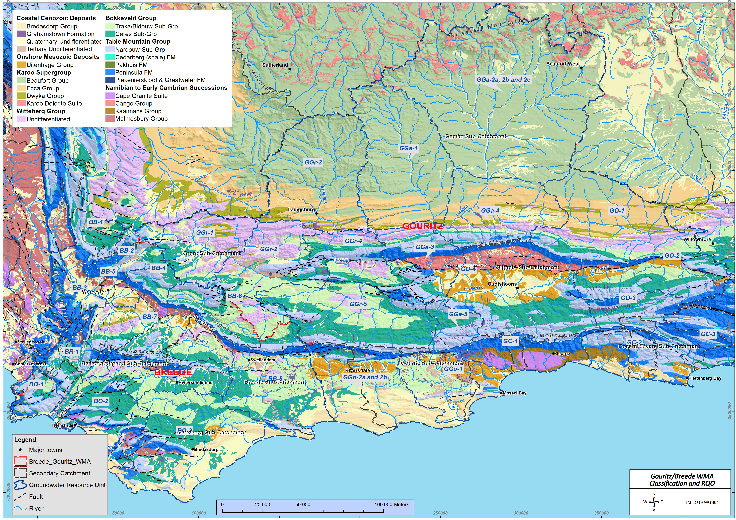
Groundwater resource units
 | Geology | Aquifer?
Oldest Youngest | Sandveld Group | Aquifer
 | Karoo Supergroup | Contains aquifers, aquitards and aquicludes
 | Cape Supergroup | Contains aquifers, aquitards and aquicludes
 | “Basement” Malmesbury Shale intruded by granite | Locally an aquifer Regionally an aquitard

Slide 5
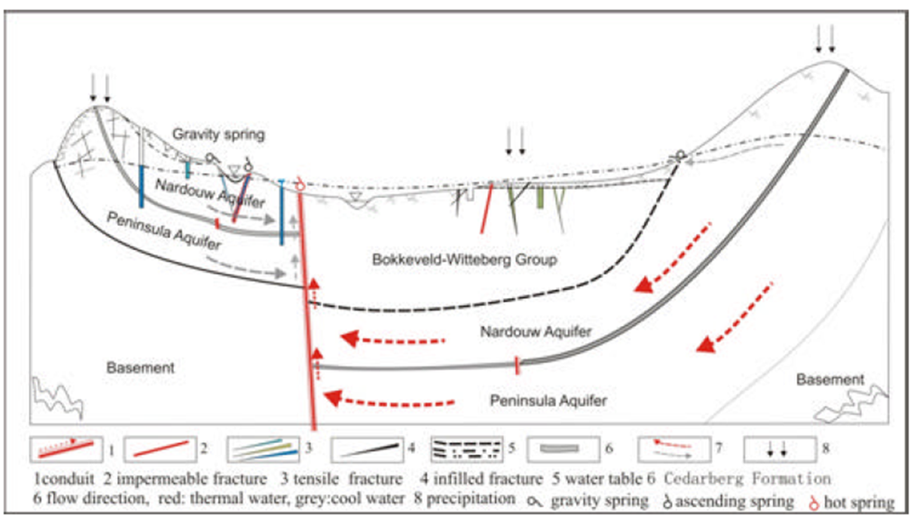
Groundwater resource units
(adapted from Wu, 2005)
Notes:
The Peninsula Formation often forms the head water of major drainage system (sometimes in the opposite direction of the deep groundwater flow system) and depending on the geological setting can contribute to recharge and groundwater flow on either side of the drainage divide. It’s generally observed that the Skurweberg aquifer contributes more directly to river baseflow both via the river bottom and via springs at the Nardouw – Cedarberg contact, while the Peninsula contributes to river flow mainly as surface run-off.
A water balance based on (surface water) catchment boundaries may lead to erroneous results.
An attempt made to define GRUs that incorporate the major inputs and outputs to the groundwater availability within that GRU area.
For consistency during the delineation process the contact between the Peninsula Formation and the reminder of the TMG and the overlying Cape Supergroup was used in cases where it was deemed necessary (i.e. main recharge/run-off area).
Using standard procedures the groundwater classification can be applied to each resource unit but with scrutiny some links will exist between resource units.
Also applied the classification process to all quaternary catchments within the GRU – but – the water balance type estimates at catchment scale are subject to greater inaccuracy / misrepresentation

Slide 6
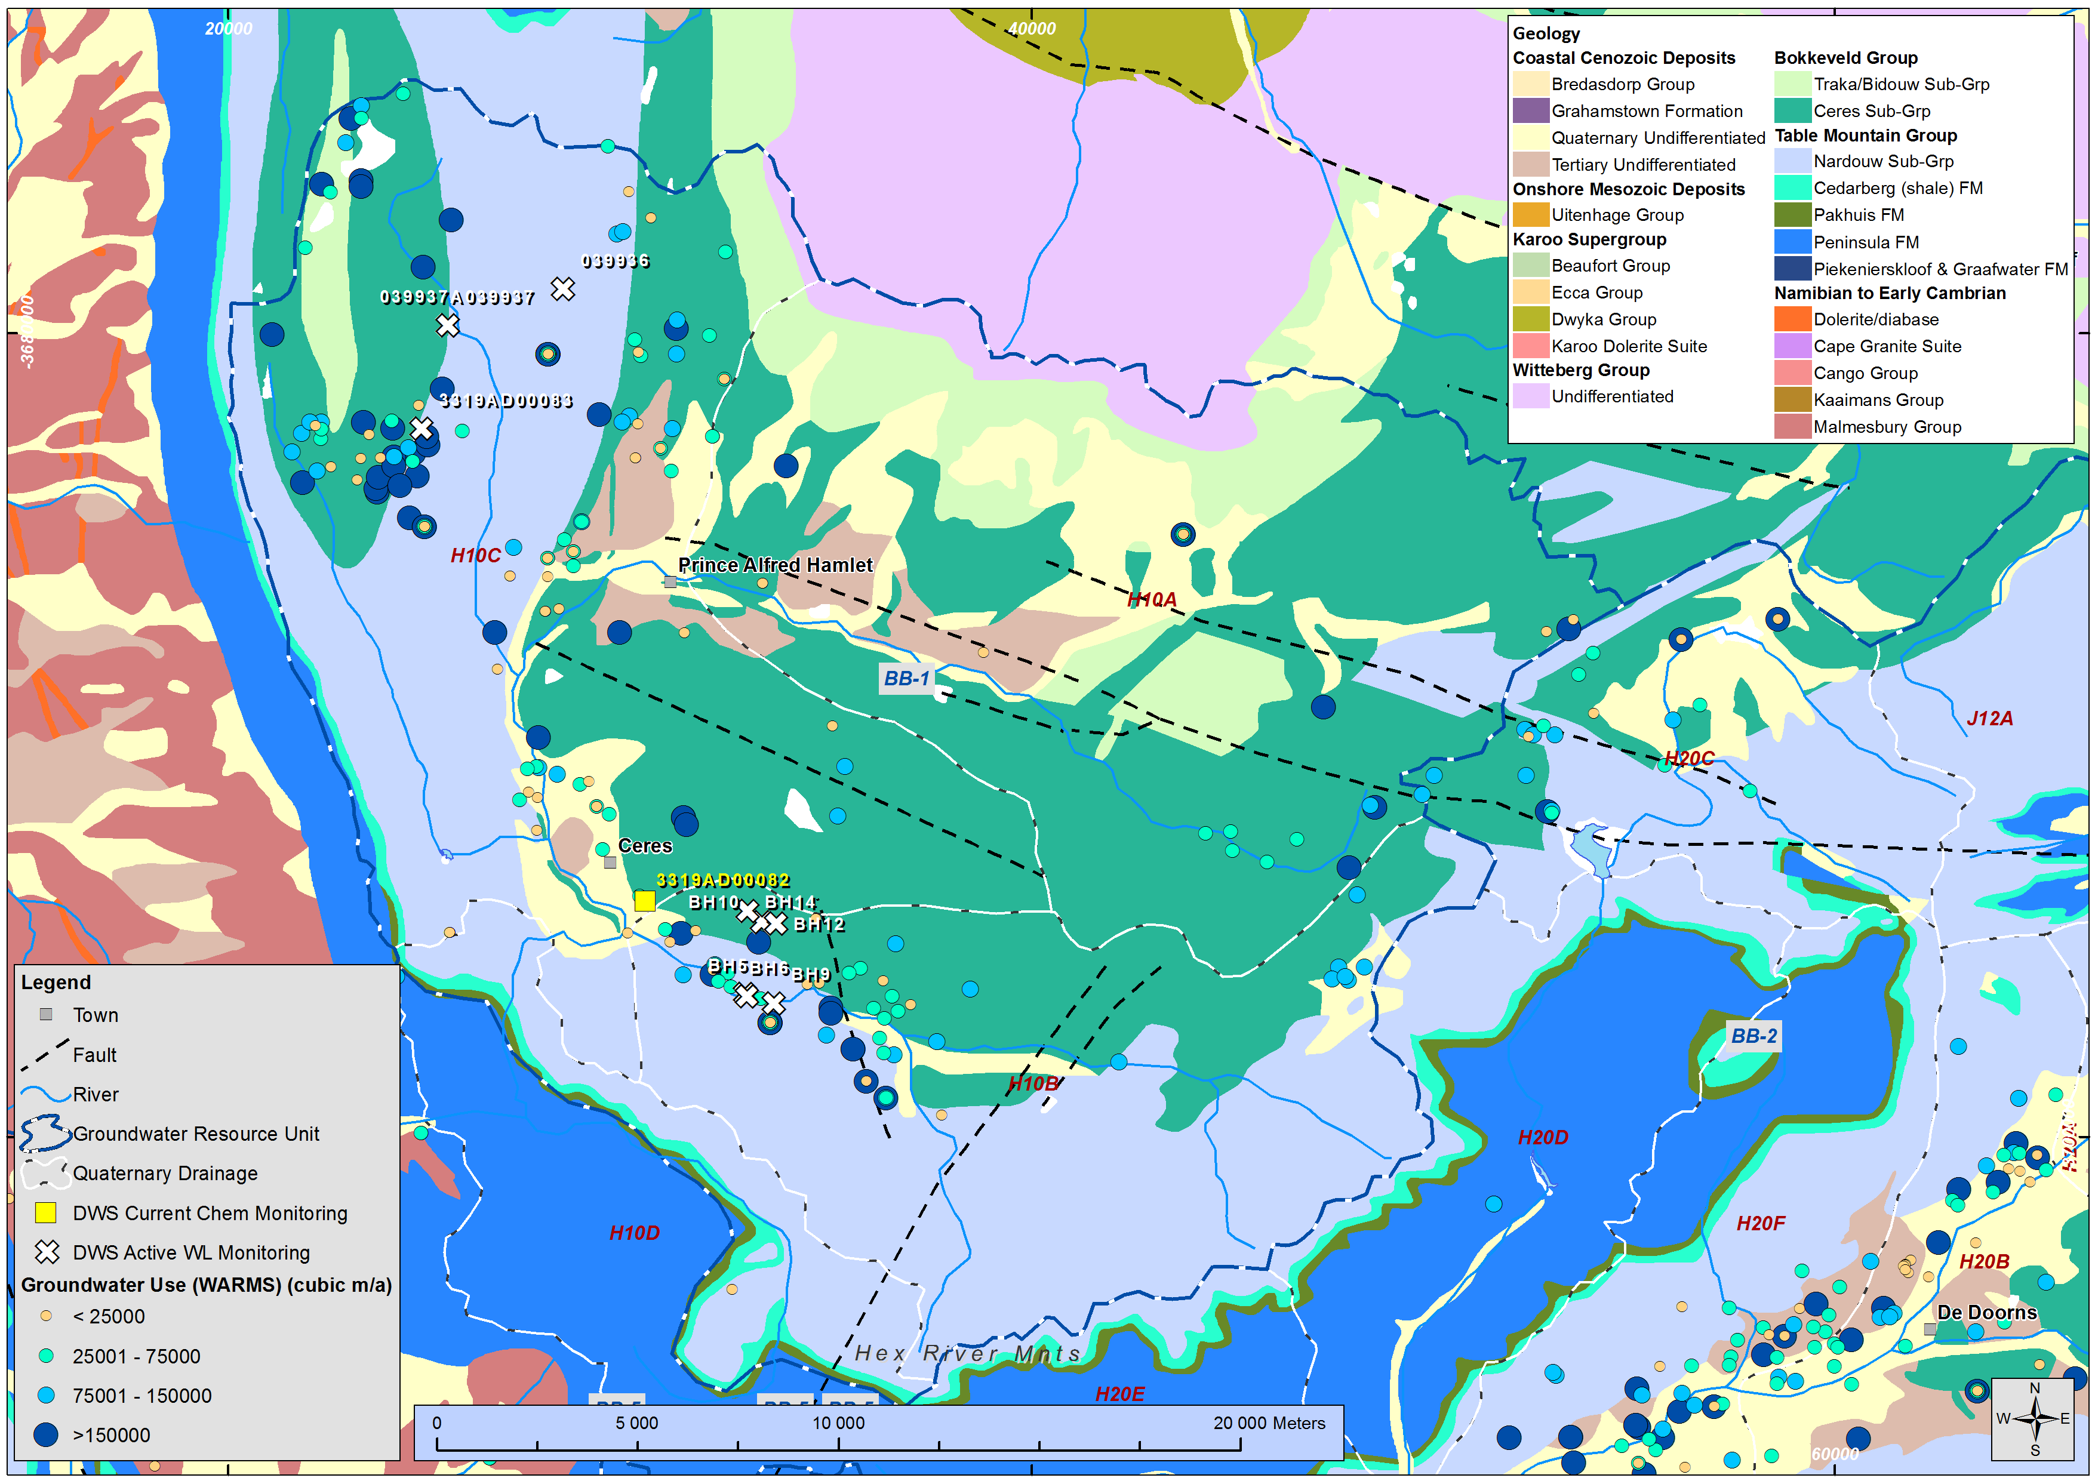
Groundwater resource units
Notes:
The overall Berg catchment boundary bounds the unit to the north. To the west the boundary follows the axis of the Hansiesberg Anticline. It was assumed that the major groundwater will flow towards the Berg WMA along the centre of the Agter-Witzenberg Syncline axis. The eastern boundary follows the quaternary catchment boundaries enclosing the H10 catchment.

Slide 7
Summary
Primary catchment | GRU | Quaternary catchment | IUA
Overberg | BO-1 | G40A to G40D; G40G | Overberg West
 | BO-2 | G40E to G40L | Overberg West Coastal
 | BO-3 | G40M; G50 to G50J | Overberg East Fynbos
Riviersonderend | BR-1 | H60A to H60D | Riviersonderend Theewaters
 | BR-2 | H60E to H60L | Lower Riviersonderend / Riviersonderend Theewaters
Breede | BB-1 | H10A to H10C | Upper Breede Tributaries
 | BB-2 | H20A to H20; J12A | Upper Breede Tributaries / Breede Working Tributaries
 | BB-3 | H10D to H10F; H10J;H10K | Upper Breede Tributaries / Breede Working Tributaries
 | BB -4 | H40A; H40B | Breede Working Tributaries
 | BB -5 | H10H; H20G; H20H; H40C | Upper Breede Tributaries
 | BB-6 | H30A to H30D; J12J;H70C | Breede Working Tributaries
 | BB-7 | H40D to H40L; H30E; H50A;H50B | Middle Breede Renosterveld / Breede Working Tributaries
 | BB-8 | H70A to H70K; G50K | Lower Breede Renosterveld

Slide 8
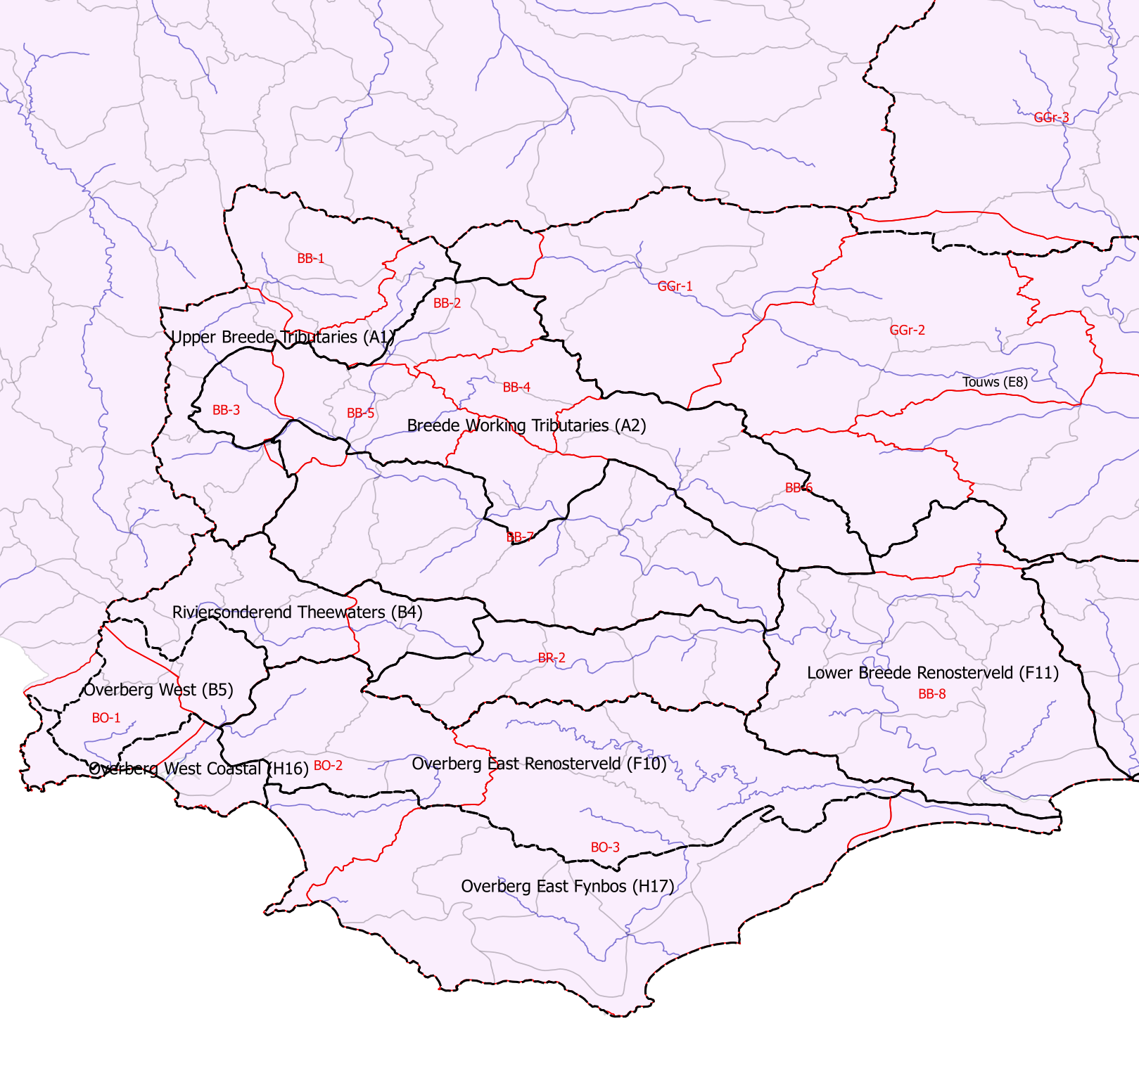
Link to IUA map
GRUs and IUAs
IUA
GRU
Quat

Slide 9
Delineation summary
We consider the data and make the necessary assessments at GRU scale, also considering neighbouring GRUs where there may be flow between them
We also provide numerical results at quaternary catchment scale, and use quaternary catchments to zoom in on areas within the GRU
From quaternary catchment scale, the information can be amalgamated up to IUA scale
RQOs developed for grouped quaternary catchments per GRU, ensuring at least 1 catchment per GRU is prioritised (where possible)

Slide 10
Recap: Status quo assessment & classification scenarios
Status quo report
  Description of major groundwater flow regime per GRU
  Description & quantification of recharge, use, discharge per GRU
  Trend analysis (water level, water quality)
EWR report
  Groundwater balance model (per GRU and quat)
  GW-SW interactions (per quat)
Scenarios report
  Groundwater present status
  Impact of development / conservation scenarios on (future) groundwater status

Slide 11
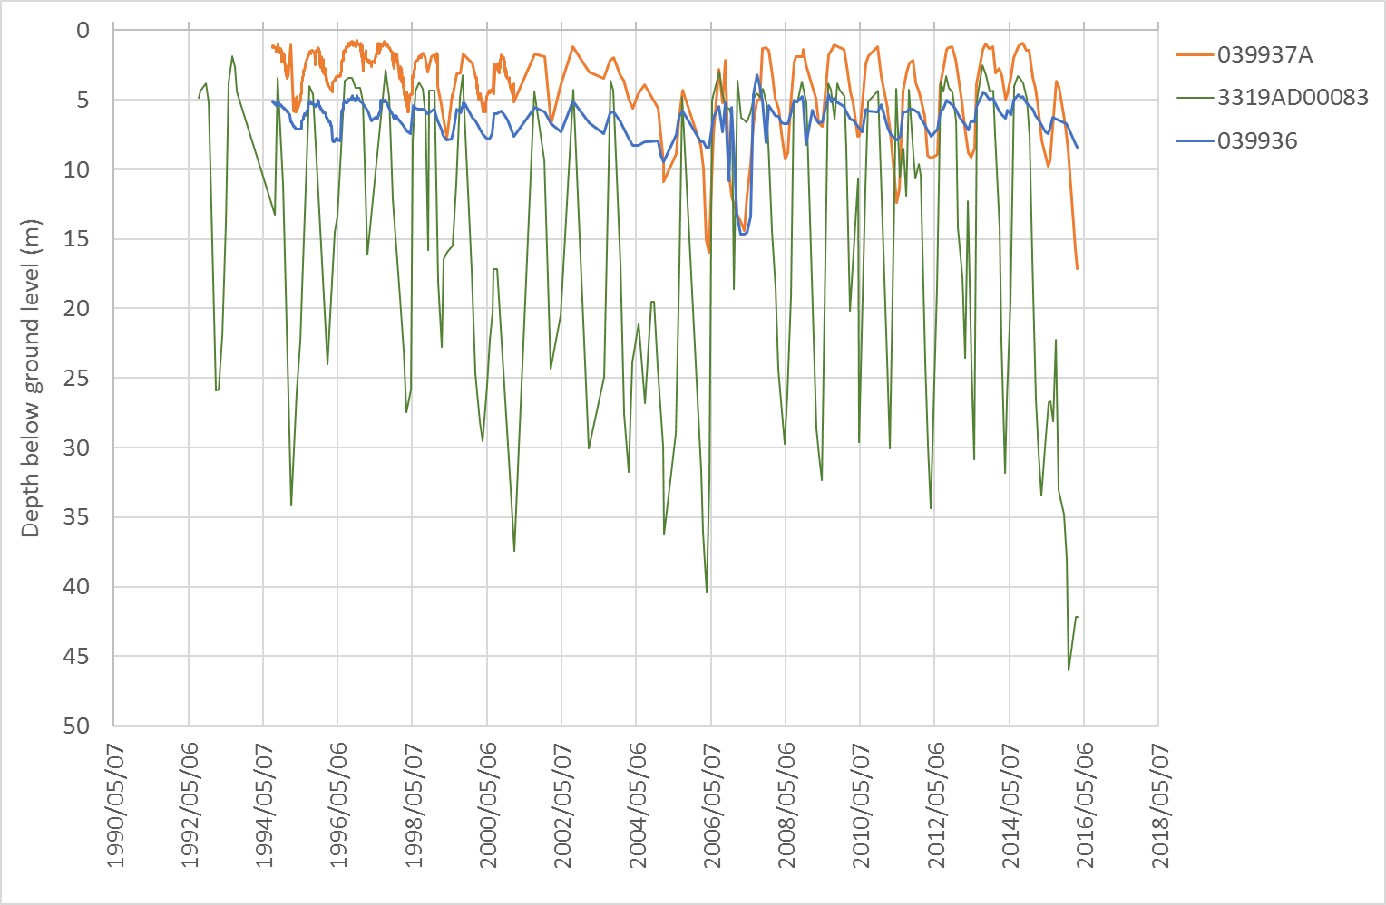
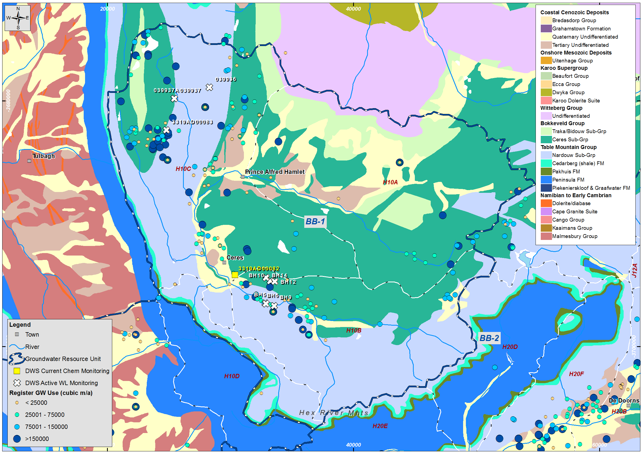
Quaternary | Recharge (Mm³/a) | Use (Mm³/a) | GWBF (Mm³/a) | Balance (Mm³/a) | Use / Recharge | Present Status
H10A | 13.15 | 3.58 | 0.76 | 8.82 | 27% | II
H10B | 12.20 | 8.86 | 0.48 | 2.86 | 73% | III
H10C | 21.28 | 26.30 | 2.00 | -7.03 | 124% | III
BB-1 | 51.60 | 38.79 | 4.03 | 8.78 | 75% | III

Slide 12
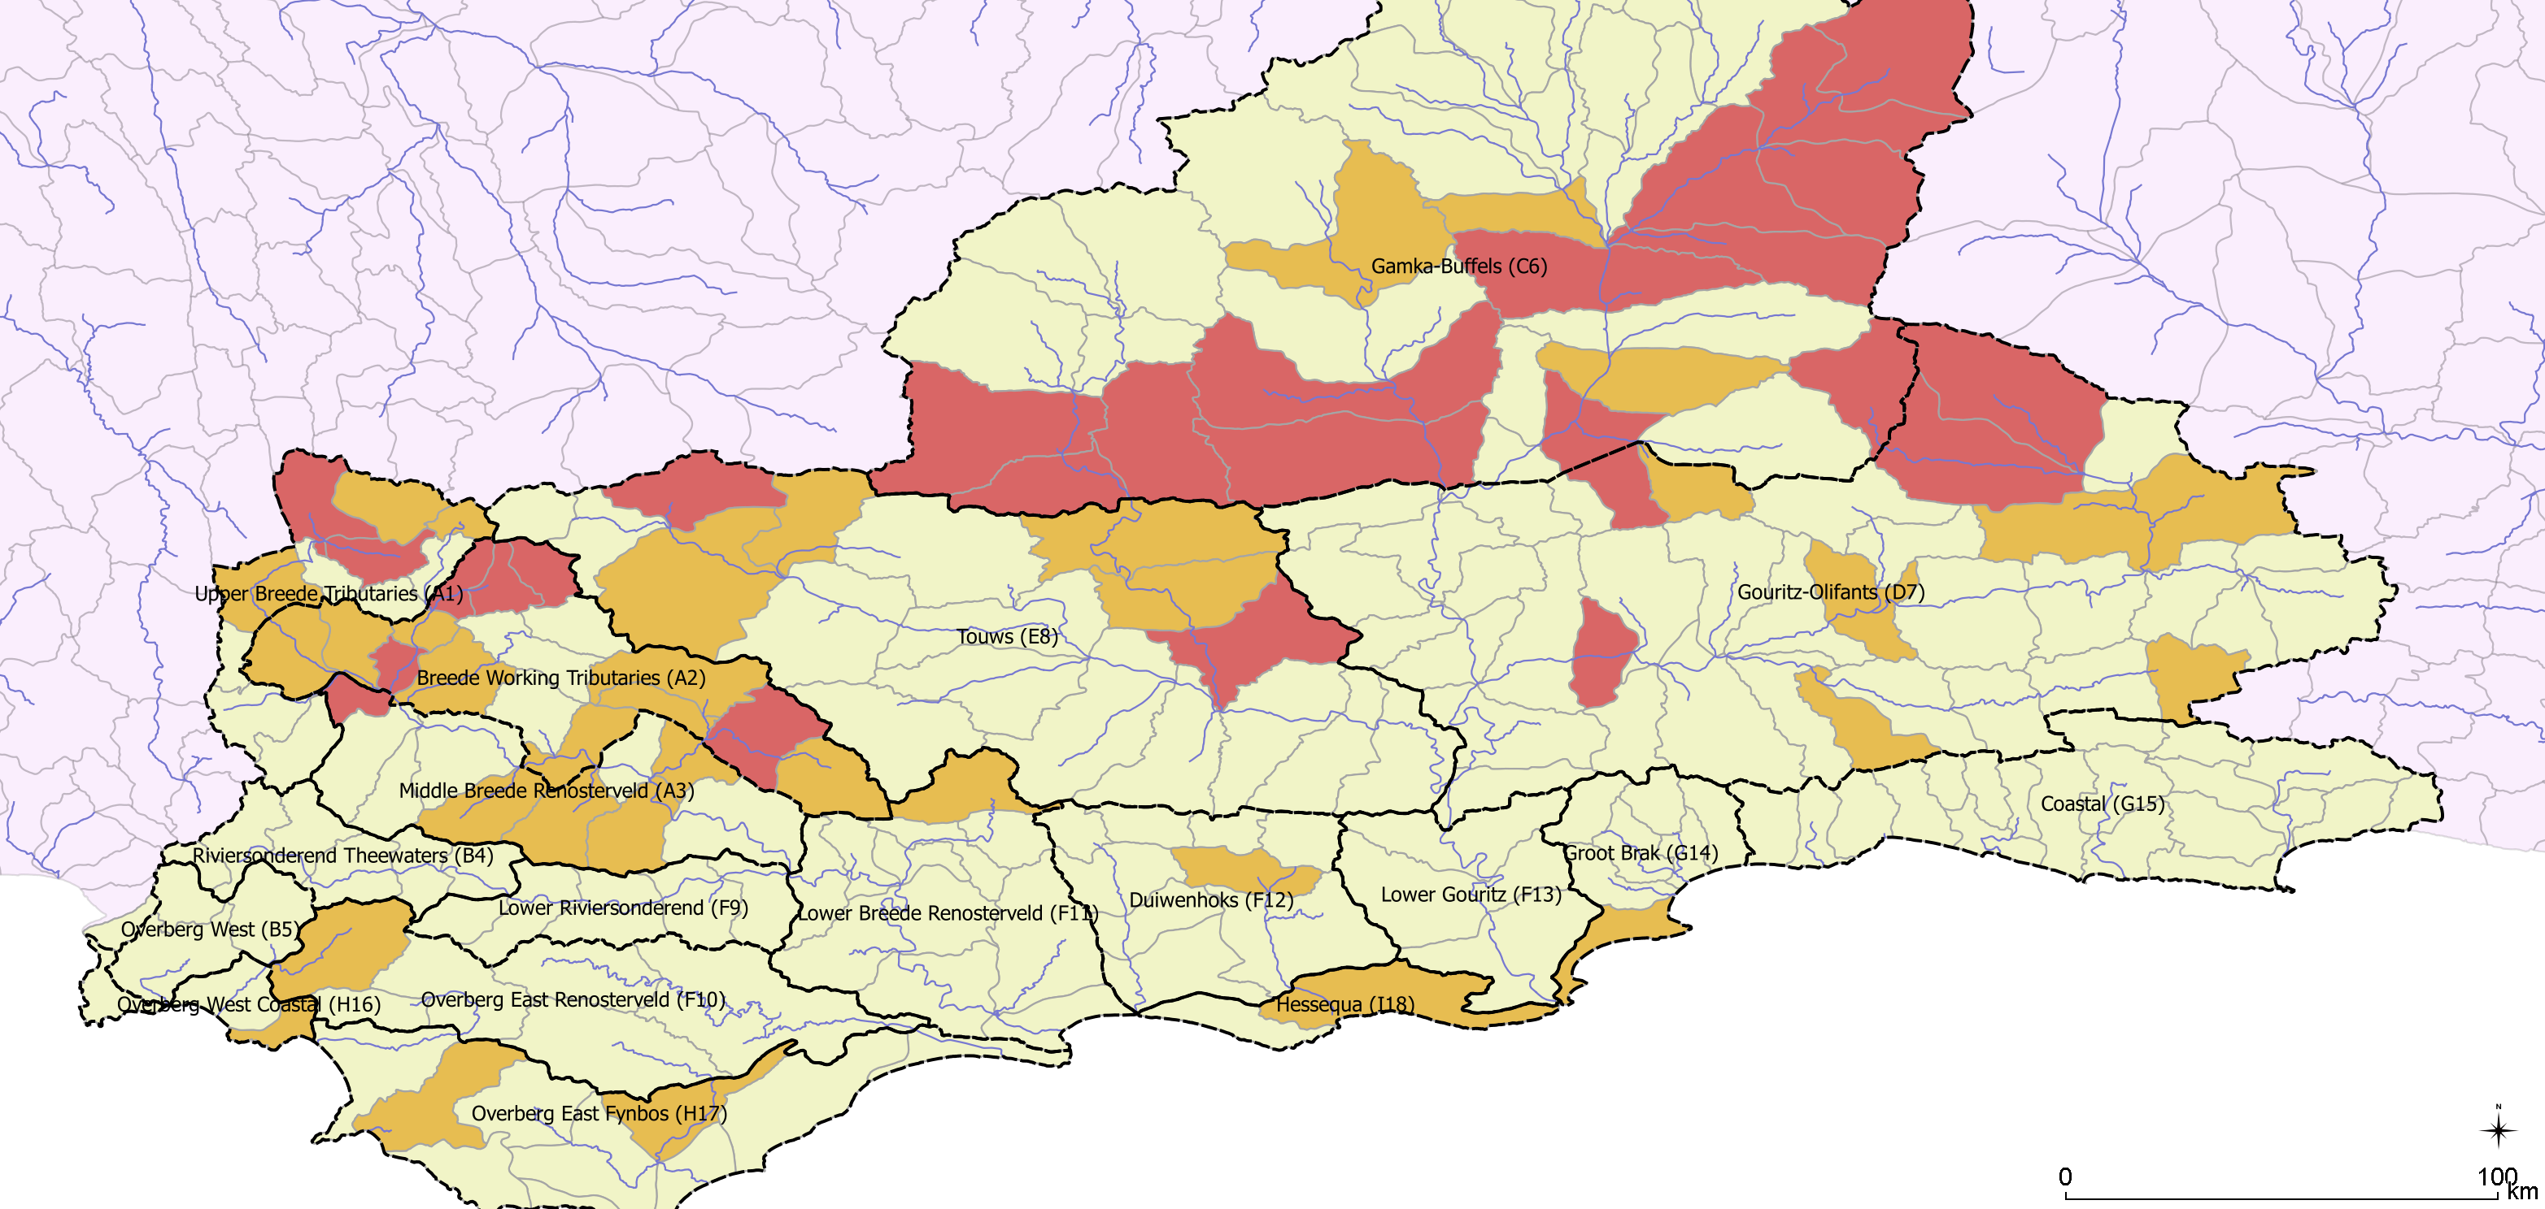
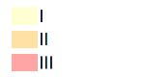
Groundwater Present status
Groundwater category

Slide 13
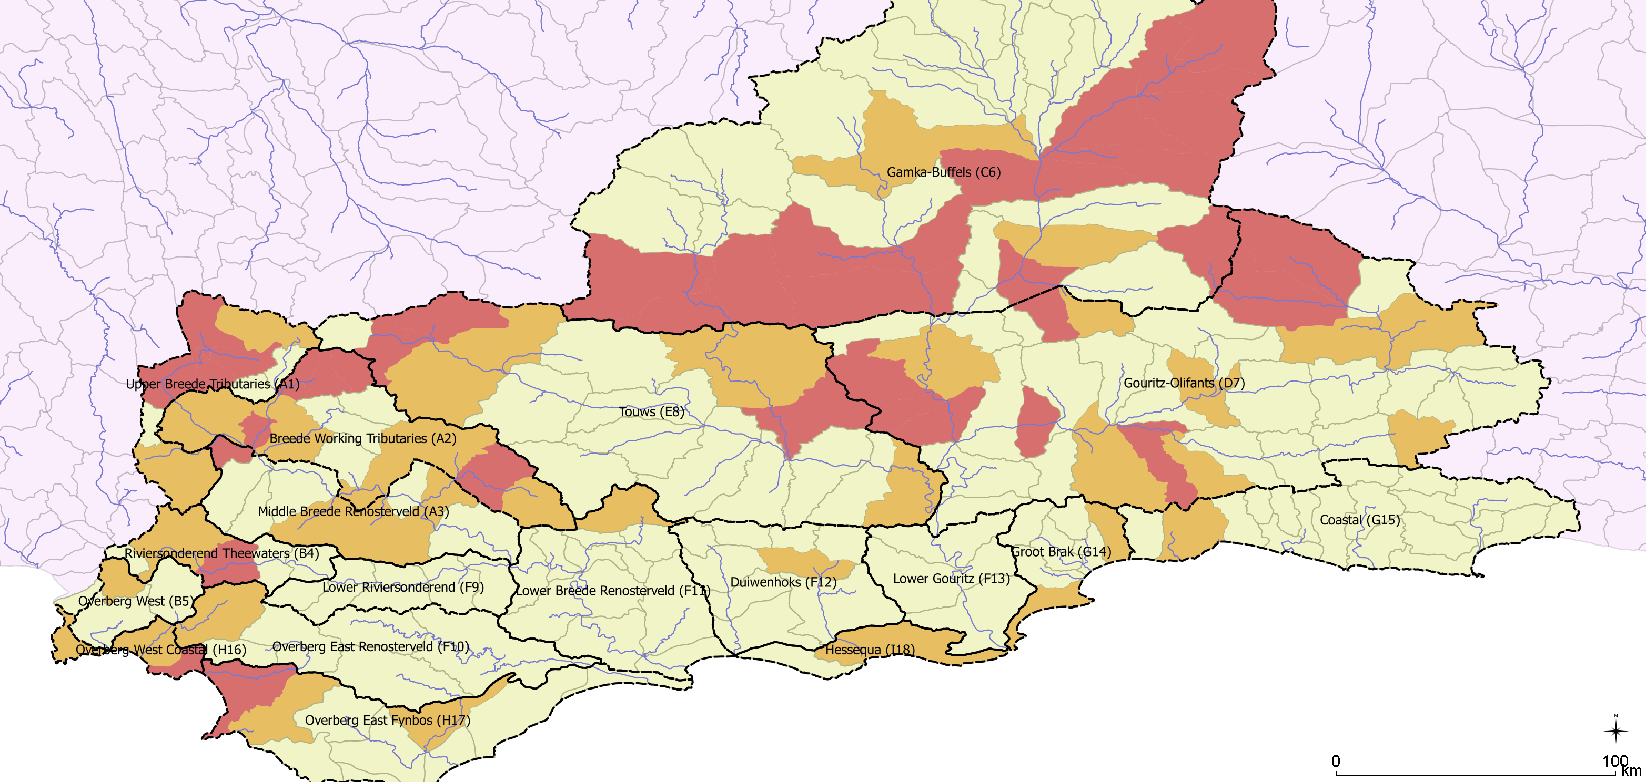
Groundwater Status under Proposed Scenario
Increase in status at 4 quats in the Upper Breede Tributaries IUA.
2 of these have significant increase.
None are high GWBF/EWR.
Moderate increase in status at 7 quats in the Gouritz-Olifants IUA.
4/7 change from I to III
None are high GWBF/EWR.
Groundwater category
Moderate increase in status at 4 quats in the Overberg West / Coastal IUA.
One quat has high GWBF/EWR: to be managed with RQOs
Notes:
Olifants IUA
KKRWSS & Calitzdorp

Slide 14
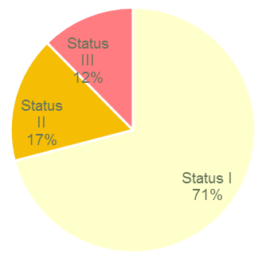
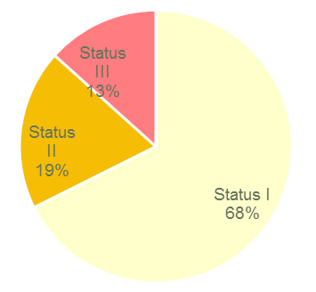
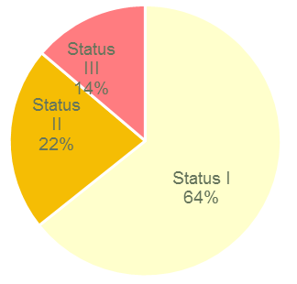
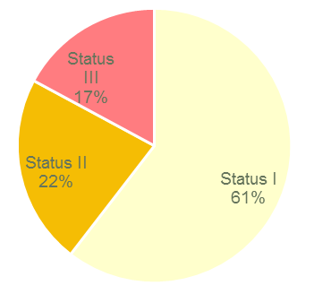
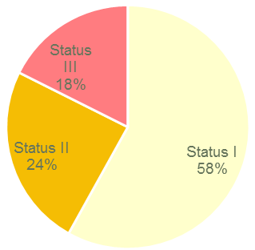
Scenario consequences for groundwater condition
 | PES – Baseline: Total groundwater use 215 million m³/a |  | Future Growth – NoEC: Total groundwater use 293 million m3/a Increase in groundwater use 36%
 | ESBC – Bottom line: Total groundwater use 338 million m3/a Increase in groundwater use 57% |  | Spatially targeted: Total groundwater use 429 million m3/a Increase in groundwater use 99%
 | REC: Total groundwater use 482 million m3/a Increase in groundwater use 124%

Slide 15
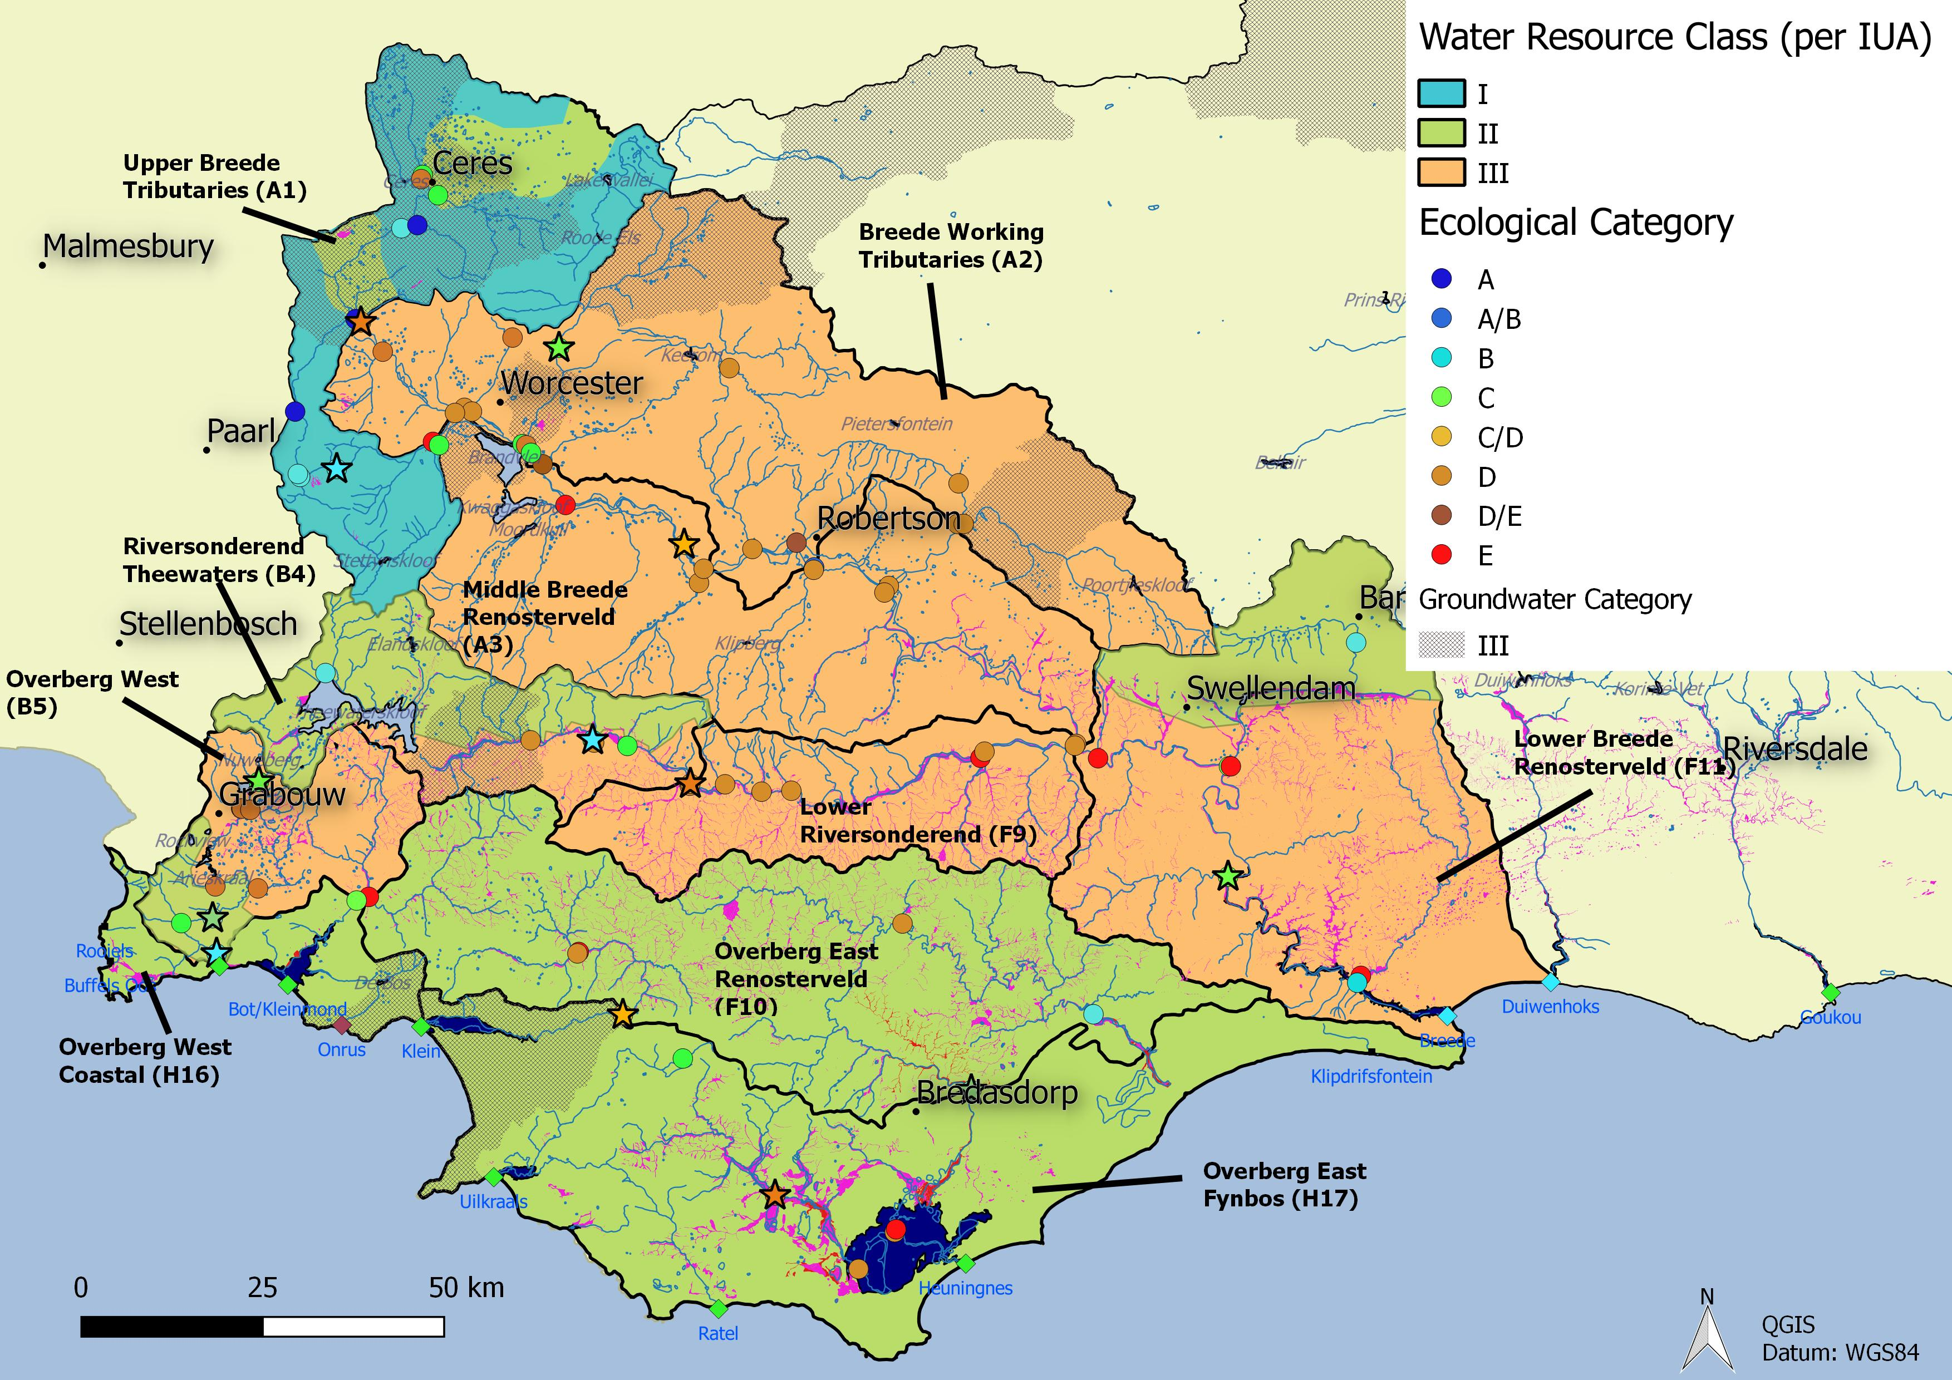
Spatially Targeted - Breede-Overberg Region
Breede-Overberg

Slide 16
Overview
Present the methodology followed to prioritise Resource Units
  Recap: Delineation of groundwater resource units
  Recap: Status quo assessment, classification scenarios
  Prioritisation
Present the methodology followed to evaluate Resource Units
  Selection of sub-components (criteria), indicators
Present the draft Resource Quality Objectives for Resource Units
  Numerical limits, narrative limits

Slide 17
Prioritisation Criterion
A set of criteria and sub-criteria were selected based on:
  The framework for RU prioritisation (DWA, 2011)
  Previous studies (specifically the Olifants-Doorn and Olifants)
  Applied to quaternary catchment scale, grouped together and handled per GRU in RQOs
Criterion | Weights (%)
Importance for users | 25
Level of surface water – groundwater interaction | 30
Threat posed to users | 30
Practical Considerations | 15

Slide 18
Prioritisation sub-criteria
Criterion | Weights (%) | Sub-criteria | Weights (%) | Rating guidelines
Importance for users | 25 | RUs most important in supporting 'sole-supply' settlements | 60 | 0 – RUs which do not support sole-supply settlements
 |  |  |  | 0.5 – RUs supporting some sole-supply settlements (1-2)
 |  |  |  | 1 – RUs supporting several sole-supply settlements (>2)
 |  | RUs within strategic water source areas for groundwater (high groundwater availability & strategic use) | 20 | 0 - RUs outside of SWSA-gw
 |  |  |  | 1 – RUs within SWSA-gw
 |  | RUs most important in supporting activities contributing to economy (GDP, job creation) (e.g. commercial agriculture, industrial abstraction, bulk abstraction by water authorities) | 20 | 0 – RUs which do not directly support any activities which contribute to economy [as indicated by <0.05l/s/km2]
 |  |  |  | 0.5 – RUs which moderately support activities which provide a contribution to economy [as indicated by 0.05-0.1l/s/km2]
 |  |  |  | 1 – RUs which significantly support activities which contribute to the economy [as indicated by >0.1l/s/km2]

Slide 19
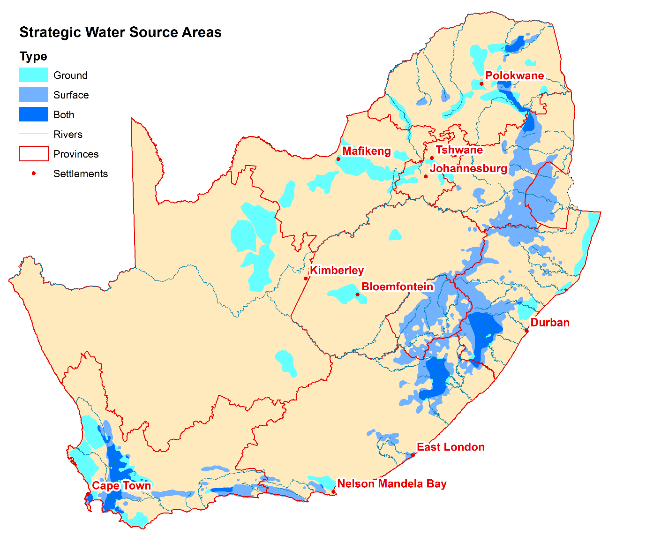

Slide 20
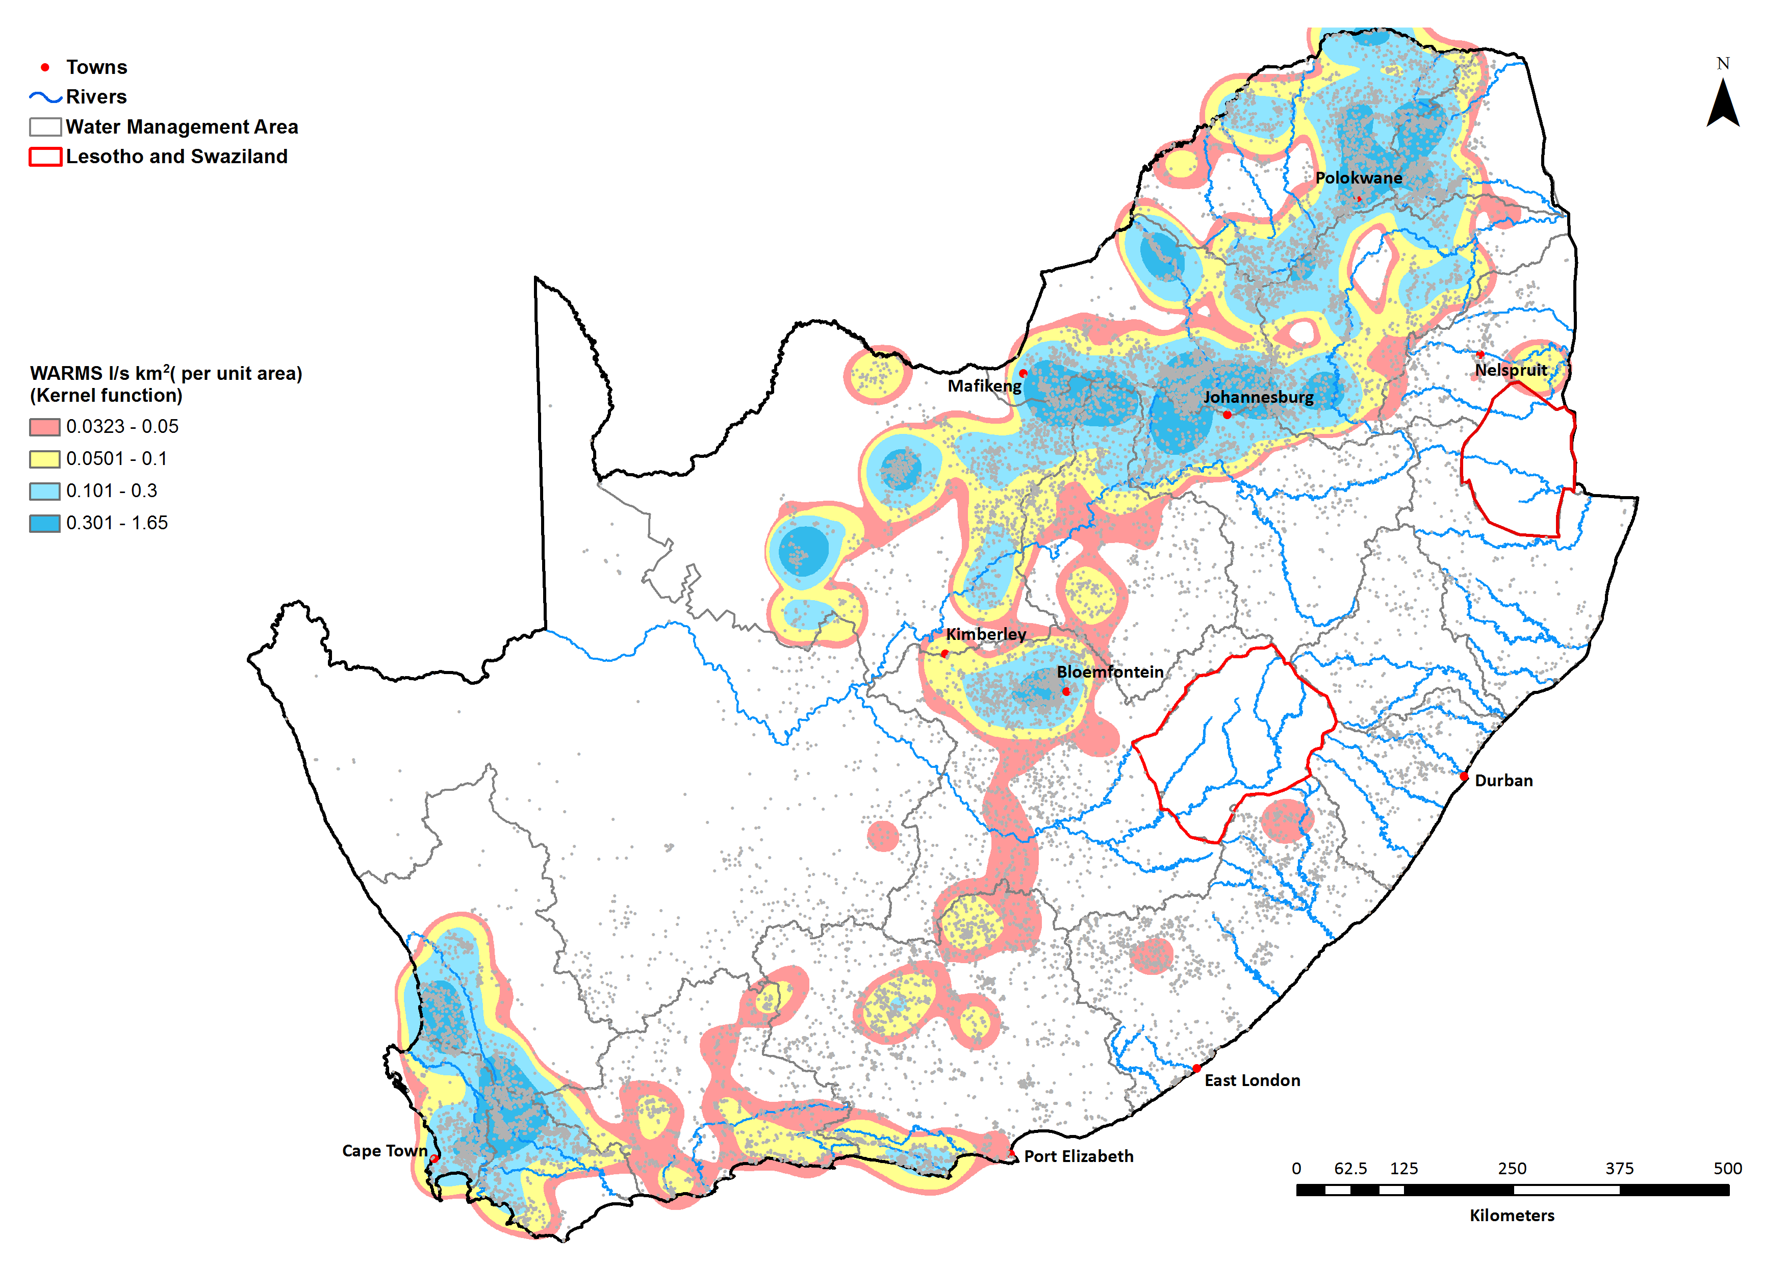
Registered Groundwater use

Slide 21
Prioritisation sub-criteria
Criterion | Weights (%) | Sub-criteria | Weights (%) | Rating guidelines
Level of surface water – groundwater interaction | 30 | Relevance of groundwater contribution to maintain required low flow conditions | 50 | 0 – RUs without relevant groundwater contribution (low GWBF/EWR) (GWBF/EWR < 11%)
 |  |  |  | 0.5 – RUs where groundwater contribution supports low flow condition (GWBF/EWR moderate, 12-75%)
 |  |  |  | 1 – RUs where groundwater contribution is crucial to maintain low flow condition (GWBF/EWR high >75%)
 |  | Relevance of groundwater contribution to maintain priority groundwater-dependent ecology | 50 | 0 – RUs without priority groundwater-dependent systems (estuaries / wetlands)
 |  |  |  | 0.5 – RUs with some priority groundwater-dependent systems (estuaries / wetlands) (<200ha)
 |  |  |  | 1 – RUs with significant area of groundwater-dependent systems (estuaries / wetlands) (>200ha)

Slide 22
GWBF / EWR
Range (%) | Count of quats
0-11 | 63
12-75 | 36
>75 | 12

Slide 23
Prioritisation sub-criteria
Criterion | Weights (%) | Sub-criteria | Weights (%) | Rating guidelines
Threat posed to users | 30 | Medium to Long-term declining trend in water or piezometric levels | 35 | 0 – RUs where no trend is visible
 |  |  |  | 0.5 – RUs where short-term trend is potentially visible, or minor
 |  |  |  | 1 – RUs where long-term trend is visible, or where no data is available to assess trend
 |  | Medium to Long-term declining trend in natural water quality | 35 | 0 – RUs where no trend is visible
 |  |  |  | 0.5 – RUs where short-term trend is potentially visible, or minor
 |  |  |  | 1 – RUs where long-term trend is visible, or where no data is available to assess trend
 |  | Presence of high stress category (currently) | 15 | 0 – RUs where stress is low (category I)
 |  |  |  | 0.5 – RUs where stress is moderate (category II)
 |  |  |  | 1 – RUs where stress is high (category III)
 |  | Presence of high stress category (future) | 15 | 0 – RUs where stress is low (category I)
 |  |  |  | 0.5 – RUs where stress is moderate (category II)
 |  |  |  | 1 – RUs where stress is high (category III)

Slide 24
Prioritisation sub-criteria
Criterion | Weights (%) | Sub-criteria | Weights (%) | Rating guidelines
Practical Considerations | 15 | Availability of water quality monitoring data (WMS monitoring boreholes) located within RU? | 50 | 0 – RUs where no resource quality information exists
 |  |  |  | 0.5 – RUs for which a moderate level of resource quality information exists (1-4 points)
 |  |  |  | 1 – RUs for which there is a good availability of resource quality information (>4 points)
 |  | Availability of water level monitoring data (DWA monitoring boreholes) located within RU? | 50 | 0 – RUs where no water level information exists
 |  |  |  | 0.5 – RUs for which a moderate level of water level information exists (1-4 points)
 |  |  |  | 1 – RUs for which there is a good availability of water level information (>4 points)

Slide 25
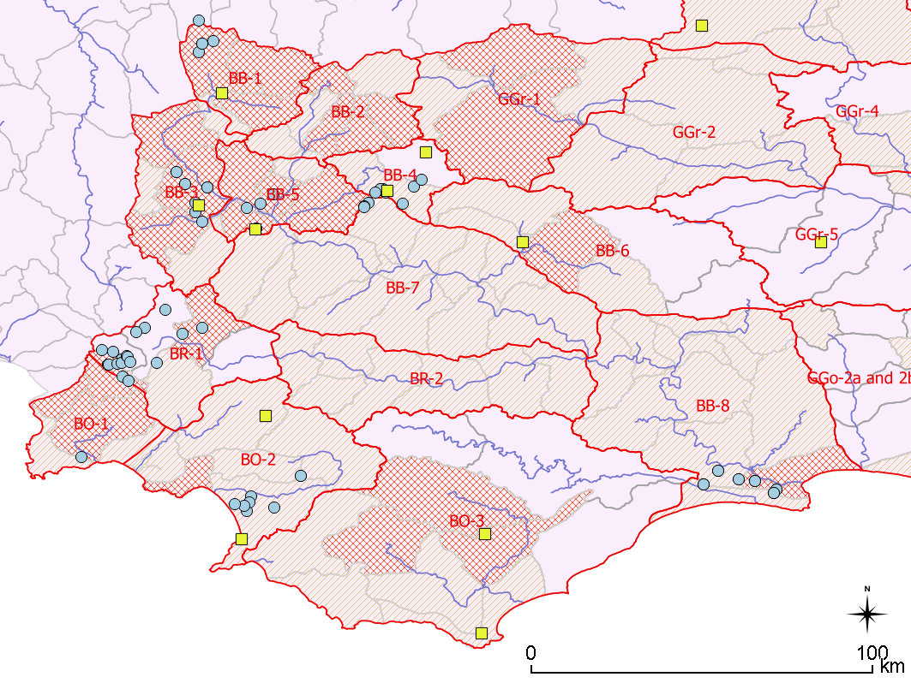
Current DWS monitoring (HYDSTRA, WMS)
Water quality
Water level

Slide 26
Prioritisation scoring
Only one rating can be applied per resource unit, whereas the sub-criteria can have a spatial variability. The sub-criteria category which covers the largest part of the resource unit, or a worst case, was applied.
Score: 0 – 100
Score divided into three categories based on the distribution of the final scores
  1 (not priority) - <18 [57, or 27%]
  2 (low priority) - 18 – 35.25 [121, or 58%]
  3 (high priority) - >35.25 [32, or 15%]

Slide 27
Prioritisation scoring
Diverted from this scoring where:
  in GRUs with no quaternary catchments scoring a “3”, the quaternary catchment with the highest score within that GRU was manually assigned a “3”. (Red)
  Scoring resulted with a “3”; however no data exists on which to base RQOs, demoted to “2”

Slide 28
Prioritisation results
IUA | GRU | Quat | RU PRIORITY | SCORE
[Berg] | BO-1 | G40A | 3 | 38.5
Overberg West | BO-1 | G40C | 3 | 48.3
Overberg West | BO-1 | G40D | 3 | 42.3
Overberg West Coastal | BO-2 | G40H | 3 | 39.3
Overberg East Fynbos | BO-3 | G50B | 3 | 47.5
Overberg East Renosterveld | BO-3 | G50D | 3 | 42.5
Overberg East Fynbos | BO-3 | G50E | 3 | 53.8
Upper Breede Tributaries | BB-1 | H10A | 3 | 35.5
Upper Breede Tributaries | BB-1 | H10B | 3 | 40.0
Upper Breede Tributaries | BB-1 | H10C | 3 | 58.8
Upper Breede Tributaries | BB-3 | H10F | 3 | 45.3
Breede Working Tributaries | BB-3 | H10G | 3 | 51.3
Breede Working Tributaries | BB-5 | H10H | 3 | 36.3
Upper Breede Tributaries | BB-3 | H10J | 3 | 44.5
Breede Working Tributaries | BB-3 | H10L | 3 | 37.0
Breede Working Tributaries | BB-2 | H20A | 3 | 40.0
Breede Working Tributaries | BB-2 | H20B | 3 | 40.0
Upper Breede Tributaries | BB-2 | H20C | 3 | 35.5
Breede Working Tributaries | BB-2 | H20F | 3 | 40.0
Breede Working Tributaries | BB-5 | H20H | 3 | 40.8
Breede Working Tributaries | BB-6 | H30B | 3 | 29.5
Breede Working Tributaries | BB-5 | H40C | 3 | 36.3
Riviersonderend Theewaters | BR-1 | H60C | 3 | 23.5
Lower Breede Renosterveld | BB-8 | H70K | 3 | 18.0
Total:
24 quats
10 GRUs (of 13)
9 IUAs (of 10)

Slide 29
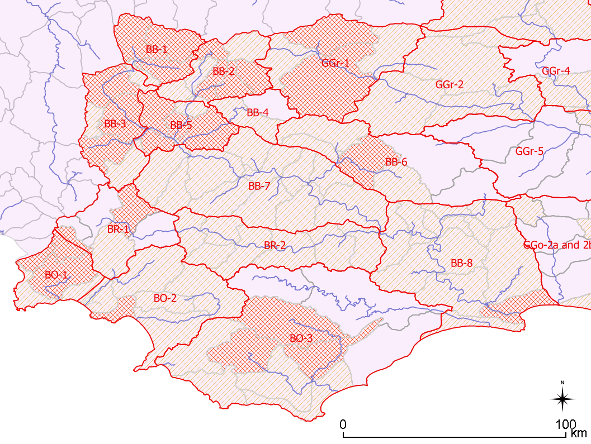
Prioritisation result
3 High priority
2 Low priority
1 Not priority

Slide 30
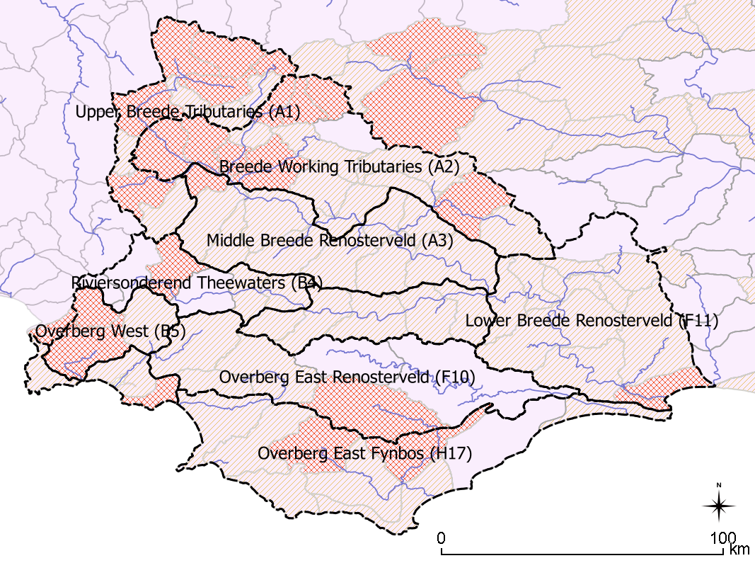
Prioritisation result

Slide 31
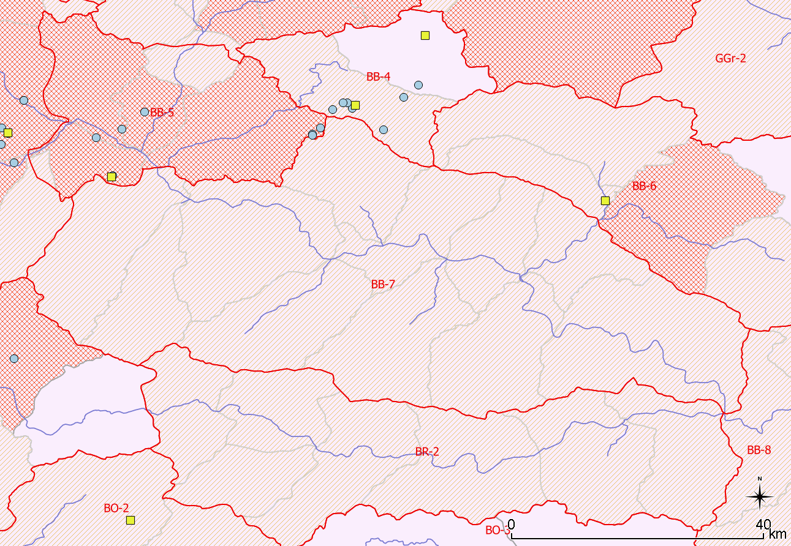
Prioritisation result
BB-4: Low scores. No GW dependent towns. Status quo shows WL and WQ stable
BB-7: Some high scores, no GW dependent towns, insufficient data to establish baseline & recent trends (see Status Quo).
BR-2: Low scores, no GW dependent towns. No data available to establish baseline / trends.

Slide 32
Prioritisation example: H10C
Quaternary | Recharge (Mm³/a) | Use (Mm³/a) | GWBF (Mm³/a) | Balance (Mm³/a) | Use / Recharge | Present Status
H10A | 13.15 | 3.58 | 0.76 | 8.82 | 27% | II
H10B | 12.20 | 8.86 | 0.48 | 2.86 | 73% | III
H10C | 21.28 | 26.30 | 2.00 | -7.03 | 124% | III
BB-1 | 51.60 | 38.79 | 4.03 | 8.78 | 75% | III

Slide 33
Prioritisation example
See EXCEL sheet

Slide 34
Discussion
Indicators, data used to support them
Scoring system
Prioritisation results - any adjustments necessary

Slide 35
Groundwater
2. Evaluation of GRUs
Notes:
Erik and team to present the methodology used for scenario evaluation

Slide 36
Evaluation of RUs
Identify sub-components that may be important to users and the environment (per RU) and select indicators for which RQOs and Numerical Limits should be developed.
Resource Unit Evaluation Tool used as a guideline - the components routinely considered for rivers (quality, quantity) are equally applicable to groundwater.
Recent examples from other catchments, specifically the Olifants-Doorn (DWS, 2014), and the Inkomati-Usuthu (DWS, 2015).

Slide 37
Evaluation of RUs
Component | Sub-Component | Indicator
Available Yield | Abstraction | Water level recovers from abstraction impact during wet season, under consideration of climate change and drought cycles
 | Groundwater level | Water level
Quantity | Discharge | Relative water levels between groundwater and surface water
 | Low flow in river | Compliance with the lowflow requirements in the river
Quality | Nutrients | NO₃/NO₂
 | Salts | EC
 | Pathogens | E-coli
 | Pathogens | Total Coliform
2. Develop an RQO (objective- descriptive), and numerical limit per indicator (if possible)
3. Per major aquifer, per prioritised quaternary (grouped per GRU)
1. Consider the relevant components / sub-components / Indicators in each prioritised RU

Slide 38
Groundwater
3. RQOs
Notes:
Erik and team to present the methodology used for scenario evaluation

Slide 39
Discussion of RQOs, numerical values, and ‘supporting information’
Component | Sub-Component | RQO Description (narrative) | Indicator | Numerical Value | Supporting information
Available Yield | Abstraction | Groundwater use should be sustainable for all users and the environment | Water level recovers from abstraction impact during wet season, under consideration of climate change and drought cycles. | n/a | Whilst exploiting groundwater storage is acceptable for managing drought, and could be acceptable for short periods to bridge the transition to other bulk water supplies (i.e. 5-10 yers desalination/ re-use), over the long-term, groundwater use should be sustainable for all users and the environment. The RQO essentially implies that groundwater mining is considered unacceptable in the long-term. Implementation of this RQO requires the authority to isolate the cause of groundwater level decline, and identify over-abstraction (unacceptable) from transition to new dynamic equilibrium (unavoidable), drought and climate change (unavoidable).
Available Yield (and quality) | Groundwater level | Minimum water level in abstraction boreholes within 2.5km from the ocean to avoid saline intrusion | Water level | 0.5 or 1 mamsl | Saline intrusion is a risk in coastal aquifers, and maintaining groundwater levels above sea level prevents saline intrusion via upconing and direct intrusion.
Quantity | Discharge | The natural gradient between groundwater and surface water should be maintained | Relative water levels between groundwater and surface water (in mamsl) | n/a | Groundwater use should be sustainable for all users and the environment. In areas where groundwater and surface water are hydraulically connected, it is assumed that the reversal of the natural gradient with surface water would have unacceptable impacts. Where groundwater discharges to surface water, groundwater abstraction close to surface water (distance dependent on aquifer diffusivity), or groundwater abstraction rates that reduce aquifer water levels beneath that of the river, would reverse the gradient towards the river, and surface water would be 'lost' to groundwater (indirect recharge). The setting of this RQO assumes that this would be unacceptable (for surface water resources / ecology).
 | Discharge | No groundwater abstraction around wetland and river FEPAs in accordance with the implementation manual for FEPAs. | Buffer zones | 250m | Whilst all abstraction reduces natural discharge to some extent and at some point in time, the timing of surface water depletion (the response time) is related to the distance to surface water, and the hydraulic diffusivity. It is therefore aquifer- and abstraction location- specific. Abstraction far from surface water, and in an aquifer with lower diffusivity, may for all practical purposes not impact on surface water (for millennia). Given the variability in hydraulic diffusivity even at different locations within the same aquifer, the data is not available in order to determine area-specific numerical values. The numerical value listed is in alignment with best-practice guidelines.
 | Low flow in river | Compliance to the low flow requirements in the river, as per surface water RQO requirement | Compliance with the lowflow requirements in the river | (Case specific) | It is assumed that the maintenance low flow is derived from groundwater. Whilst all abstraction reduces natural discharge to some extent and at some point in time, it would be unacceptable for abstraction to cause groundwater discharge to reduce below the maintenance low flow value required in the catchment to meet the surface water RQOs.
Quality | Nutrients | Groundwater should be fit for domestic use after treatment; and groundwater quality shall not deteriorate from natural background | NO₃ (as N) | (Case specific) | Groundwater management measures must ensure groundwater quality is protected. The parameters selected will support identification of a variety of pollution sources (captured in increase in salts), agricultural pollution (fertilisers), and saline intrusion. The numerical values represent either the 90 or the 95 percentile for the listed aquifer within the GRU. This is taken as a limit of acceptable deviation from natural background. Where insufficient data exists to establish robust statistics for an aquifer within an area, numerical values are either taken from the same aquifer in neighbouring areas or from data for the same aquifer across the region. In certain cases where local data is not available, and where regional data is considered inapplicable for this area, drinking water quality standards are used.
 | Salts |  | EC | (Case specific)
 | Pathogens |  | E-coli | 0 counts / 100 ml | Groundwater management measures must ensure groundwater quality is protected. The parameters selected will support identification of pollution from waste water (pathogens) and other bacteriological sources. The numerical value is based on drinking water quality standards.
 | Pathogens |  | Total Coliform | 10 counts / 100ml
Refer to handout

Slide 40
Sub-component: abstraction, Indicator: Water level
Drought cycle?
Drought…

Slide 41
Sub-component: abstraction, Indicator: Water level

Slide 42
Component: Water quality
Status quo report contains
  Statistics for main chemical parameters per major geology per GRU
Analysis for RQO development included
  Statistics for main chemical parameters per major geology per catchment
  Establish “natural background” per major geology per catchment, and natural variability (majority are ‘normal’)
  Establish appropriate limit to “natural background” (most are 95%, or 90% where 95% is poor / impacted)

Slide 43
Component: Water quality

Slide 44
RQO - full details

Slide 45
BB-1

Slide 46
BB-1
Excludes the buried peninsula (so not "all' and not "TMG“) given the deep peninsula may not mimic surface topography, will not be in connection with rivers, and may be drilled into.
GRU | Quat(s) | Aquifer | Component | Sub-Component | RQO Description (narrative) | Indicator | Numerical Value
BB-1 | H10A, H10B, H10C | Bokkeveld Group, Nardouw Group, Cenozoic coastal deposits | Available Yield | Abstraction | Groundwater use should be sustainable for all users and the environment | Water level recovers from abstraction impact during wet season, under consideration of climate change and drought cycles. | n/a
 |  |  | Quantity | Discharge | The natural gradient between groundwater and surface water should be maintained | Relative water levels between groundwater and suface water (in mamsl) | n/a
 |  |  |  | Discharge | No groundwater abstraction around wetland and river FEPAs in accordance with the implementation manual for FEPAs. | Buffer zones | 250m
 |  |  |  | Low flow in river | Compliance to the low flow requirements in the river, as per surface water RQO requirement | Compliance with the lowflow requirements in the river | See section 3.1
Necessary? The mountain streams discharge into the alluvium around Ceres, and this indirect recharge is enhanced by the alluvial abstraction. This maintains the high levels of abstraction in the valley: SW and GW abstraction via boreholes. With the 250m, significant impacts on ecology avoided (also catered for in the low flow maintenance, and in the SW RQOs)

Slide 47
BB-1
95% from this geology in this region
90% from this geology in this region
95% from this geology across the region
GRU | Quat(s) | Aquifer | Component | Sub-Component | RQO Description (narrative) | Indicator | Numerical Value
BB-1 | H10A, H10B, H10C | Cenozoic coastal deposits - alluvium | Quality | Nutrients | Groundwater should be fit for domestic use after treatment; and groundwater quality shall not show a deteriorating trend from natural background | NO₃ (as N) | 6.8 mg/l
 |  |  |  | Salts |  | EC | 311 mS/m
 |  | Bokkeveld Group |  | Nutrients |  | NO₃ (as N) | 2.4 mg/l
 |  |  |  | Salts |  | EC | 236 mS/m
 |  | Nardouw Group |  | Nutrients |  | NO₃ (as N) | 4.4 mg/l
 |  |  |  | Salts |  | EC | 119 mS/m
 |  | Bokkeveld Group, Nardouw Group, Cenozoic coastal deposits |  | Pathogens |  | E-coli | 0 counts / 100 ml
 |  |  |  | Pathogens |  | Total Coliform | 10 counts / 100ml

Slide 48
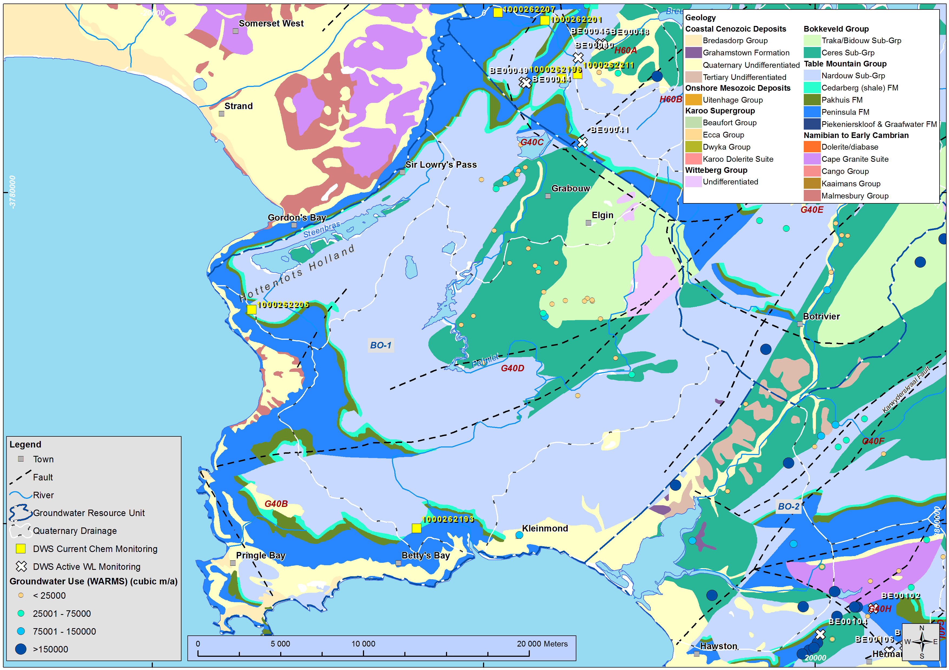
BO-1

Slide 49
BO-1
GRU | Quat(s | Aquifer | Component | Sub-Component | RQO Description (narrative) | Indicator | Numerical Value
BO-1 | G40A, G40C, G40D | All | Available Yield | Abstraction | Groundwater use should be sustainable for all users and the environment | Water level recovers from abstraction impact during wet season, under consideration of climate change and drought cycles. | n/a
 |  | Superficial aquifers | Quantity | Discharge | The natural gradient between groundwater and surface water should be maintained | Relative water levels between groundwater and suface water (in mamsl) | n/a
 |  | All |  | Discharge | No groundwater abstraction around wetland and river FEPAs in accordance with the implementation manual for FEPAs. | Buffer zones | 250m
 |  | All |  | Low flow in river | Compliance to the low flow requirements in the river, as per surface water RQO requirement | Compliance with the lowflow requirements in the river | See section 3.1
Excludes the buried TMG (so not "all‘, nor "TMG“) given the deep TMG may not mimic surface topography, will not be in connection with rivers, and abstraction may target deep discharge to coast.
Necessary: as yet no significant abstraction, assumed ecologically unacceptable to reverse gradient.
Notes:
GRU is coastal, but no major abstraction close to coastline. The “significant resources” requiring protection are TMG, which is greater distance from coast.

Slide 50
BO-1
95% from this geology across the region
TMG: Limited local data suggests pristine quality. Potentially restrictive to use this.
GRU | Quat(s) | Aquifer | Component | Sub-Component | RQO Description (narrative) | Indicator | Numerical Value
BO-1 | G40A, G40C, G40D | Bokkeveld Group | Quality | Nutrients | Groundwater should be fit for domestic use after treatment; and groundwater quality shall not show a deteriorating trend from natural background | NO₃/NO₂ | 3.6 mg/l
 |  |  |  | Salts |  | EC | 589 mS/m
 |  | Table Mountain Group |  | Nutrients |  | NO₃ (as N) | 3.8 mg/l
 |  |  |  | Salts |  | EC | 117 mS/m
 |  | All |  | Pathogens |  | E-coli | 0 counts / 100 ml
 |  | All |  | Pathogens |  | Total Coliform | 10 counts / 100ml

Slide 51
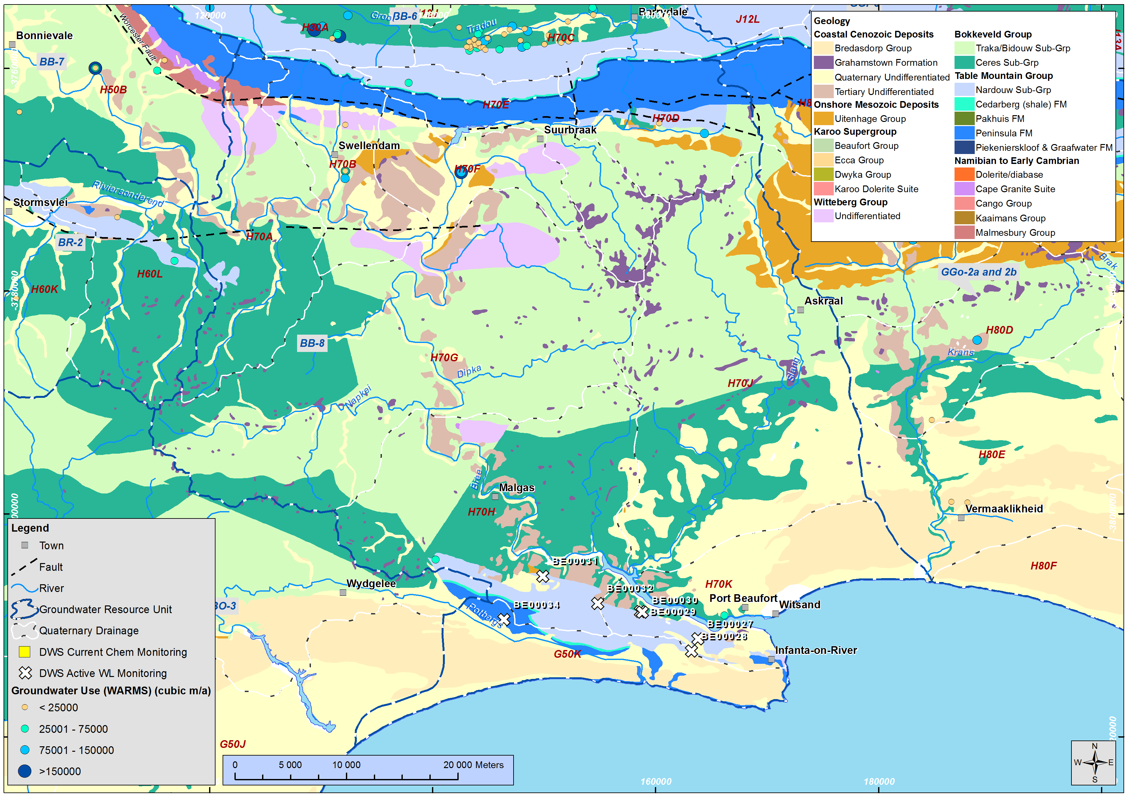
BB-8

Slide 52
BB-8
GRU | Quat(s) | Aquifer | Component | Sub-Component | RQO Description (narrative) | Indicator | Numerical Value
BB-8 | H70K | All | Available Yield | Abstraction | Groundwater use should be sustainable for all users and the environment | Water level recovers from abstraction impact during wet season, under consideration of climate change and drought cycles. | n/a
 |  | All | Available Yield (and quality) | Groundwater level | Minimum water level in abstraction boreholes within 2.5km from the ocean to avoid saline intrusion | Water level | 1 mamsl
 |  | Superficial aquifers | Quantity | Discharge | The natural gradient between groundwater and surface water should be maintained | Relative water levels between groundwater and suface water (in mamsl) | n/a
 |  | All |  | Discharge | No groundwater abstraction around wetland and river FEPAs in accordance with the implementation manual for FEPAs. | Buffer zones | 250m
 |  | All |  | Low flow in river | Compliance to the low flow requirements in the river, as per surface water RQO requirement | Compliance with the lowflow requirements in the river | See section 3.1

Slide 53
BB-8
Limited local WQ data:
95% from this geology across the region
90% from this geology across the region
GRU | Quat(s) | Aquifer | Component | Sub-Component | RQO Description (narrative) | Indicator | Numerical Value
BB-8 | H70K | Cenozoic coastal deposits | Quality | Nutrients | Groundwater should be fit for domestic use after treatment; and groundwater quality shall not show a deteriorating trend from natural background | NO₃ (as N) | 9.8 mg/l
 |  |  |  | Salts |  | EC | 280 mS/m
 |  | Bokkeveld Group |  | Nutrients |  | NO₃ (as N) | 3.6 mg/l
 |  |  |  | Salts |  | EC | 589 mS/m
 |  | Table Mountain Group |  | Nutrients |  | NO₃ (as N) | 3.8 mg/l
 |  |  |  | Salts |  | EC | 117 mS/m
 |  | All |  | Pathogens |  | E-coli | 0 counts / 100 ml
 |  |  |  | Pathogens |  | Total Coliform | 10 counts / 100ml

Slide 54
Specific interest in other areas / GRUs?

Slide 55
Discussion
Overall approach, use of aquifer specific data
Criteria & sub-criteria established
Descriptive RQOs
Numerical values applied

Slide 56
Thank you
Notes:
Erik and team to present the methodology used for scenario evaluation

Slide 57
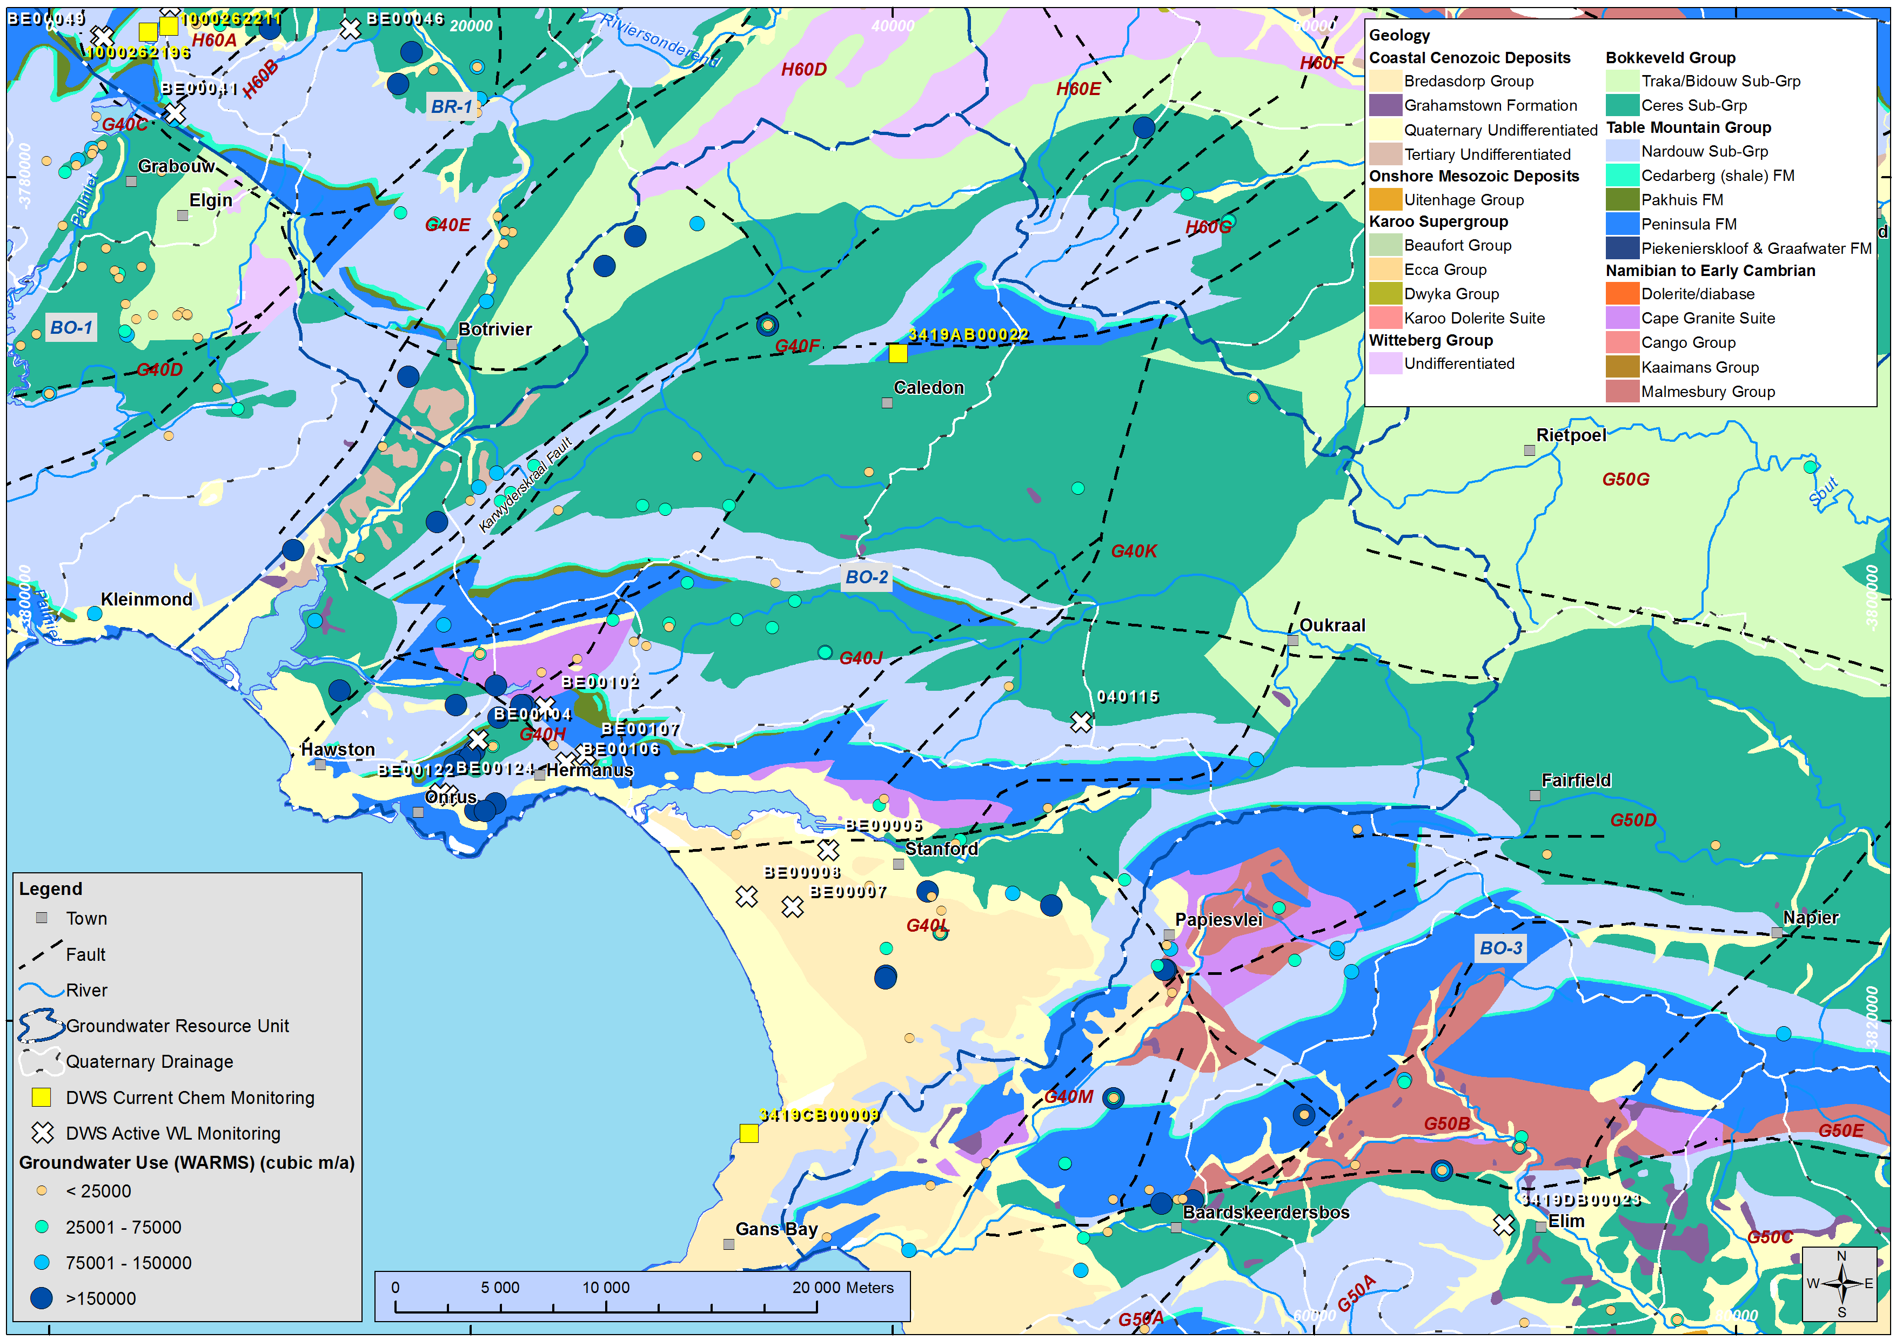
BO-2

Slide 58
BO-2
GRU | Quat(s) | Aquifer | Component | Sub-Component | RQO Description (narrative) | Indicator | Numerical Value
BO-2 | G40H | All | Available Yield | Abstraction | Groundwater use should be sustainable for all users and the environment | Water level recovers from abstraction impact during wet season, under consideration of climate change and drought cycles. | n/a
 |  | All | Available Yield (and quality) | Groundwater level | Minimum water level in abstraction boreholes within 2.5km from the ocean to avoid saline intrusion | Water level | 1 mamsl
 |  | Superficial aquifers | Quantity | Discharge | The natural gradient between groundwater and surface water should be maintained | Relative water levels between groundwater and suface water (in mamsl) | n/a
 |  | All |  | Discharge | No groundwater abstraction around wetland and river FEPAs in accordance with the implementation manual for FEPAs. | Buffer zones | 250m
 |  | All |  | Low flow in river | Compliance to the low flow requirements in the river, as per surface water RQO requirement | Compliance with the lowflow requirements in the river | See section 3.1
Coastal abstraction

Slide 59
BO-2
Limited local WQ data:
95% from this geology across the region
90% from this geology across the region
GRU | Quat(s) | Aquifer | Component | Sub-Component | RQO Description (narrative) | Indicator | Numerical Value
BO-2 | G40H | Cenozoic coastal deposits | Quality | Nutrients | Groundwater should be fit for domestic use after treatment; and groundwater quality shall not show a deteriorating trend from natural background | NO₃ (as N) | 9.8 mg/l
 |  |  |  | Salts |  | EC | 280 mS/m
 |  | Bokkeveld Group |  | Nutrients |  | NO₃ (as N) | 3.6 mg/l
 |  |  |  | Salts |  | EC | 589 mS/m
 |  | Table Mountain Group |  | Nutrients |  | NO₃ (as N) | 3.8 mg/l
 |  |  |  | Salts |  | EC | 117 mS/m
 |  | All |  | Pathogens |  | E-coli | 0 counts / 100 ml
 |  |  |  | Pathogens |  | Total Coliform | 10 counts / 100ml

Slide 60
Cause of Water level decline: background theory
Notes:
Erik and team to present the methodology used for scenario evaluation

Slide 61
The Capture Principle
Natural state: recharge & discharge dynamic equilibrium
Pumping: abstracted water met by reduced discharge &/ enhanced recharge & storage is reduced
(Theis, 1940; Lohman, 1972a and Lohman, 1972b; Delvin and Sophocleous, 2005; Seward et al 2006)

Slide 62
Maintainable aquifer yield
Maintainable aquifer yield: can be maintained indefinitely without continually mining an aquifer in a new dynamic equilibrium, such that the aquifer storage doesn’t continually deplete. It is met by reduced discharge &/ enhanced recharge
Response time: Time taken to reach the new state of dynamic equilibrium where no water is contributed from storage / no further depletion of storage

Slide 63
Response time
Transition from reliance on GW storage to reduced discharge &/ induced recharge of SW
Initially all developments mine water, eventually they do not
Shape remains
t = f(hydraulic properties and distance) not of volume abstracted
t may be days to 100’s (!) years
Sophocleous, 2000

Slide 64
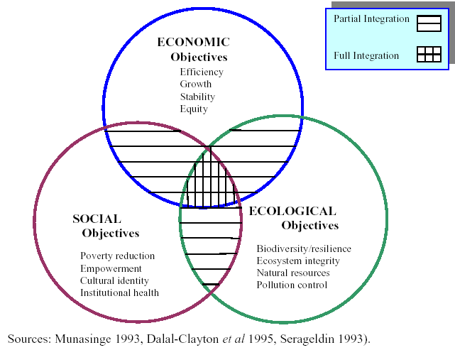
Dimensions of Sustainability
(FEE 2002)
Supported by WBI

Slide 65
Capture to sustainability - example
DWAF 2008 – Berg WAAS – Volume 6

Slide 66
Capture to sustainability
Response time
Into aquifer
(Areal recharge & abstraction not shown)
Recharge
Storage
Discharge
Acceptable impact?
Out of aquifer
Seyler & Hay, 2013

Slide 67
Sub-component: abstraction, Indicator: Water level

Slide 68
Groundwater and WRCS
– guiding principles
Notes:
Erik and team to present the methodology used for scenario evaluation

Slide 69
Groundwater’s role in WRCS
Department of Water Affairs and Forestry (DWAF), 1999. Resource Directed Measures for Protection of Water Resources Groundwater Component Version 1.0 September 1999
Dollar, E.S.J., Brown, C.A., Turpie, J.K., Joubert, A.R., Nicolson, C.R. and Manyaka, S. 2006: The development of the Water Resources Classification System (WRCS). Volume 1. Overview and 7- step classification procedure. CSIR Report No., Department of Water Affairs and Forestry, Pretoria, 70pp.
Department of Water Affairs and Forestry (DWAF), 2007a. The Development of the Water Resource Classification System (WRCS), Technical Guideline, February 2007 By Chief Directorate: Resource Directed Measures
Department of Water Affairs (DWA), 2010. Regulations for the Establishment of a Water Resource Classification System. Regulation 810 Government Gazette No. 33541 17 September 2010
Parsons, R. and J. Wentzel 2007. Groundwater Resources Directed Measures Manual WRC Report No TT 299/07. ISBN 978-1-77005-510-0. April 2007.
……..
Dennis, I., K. Witthüser, K. Vivier, R. Dennis and A. Mavurayi, 2013. Groundwater Resources Directed Measures 2012 Edition. By Water Research Commission (WRC), Report No TT 506/12, March 2013.
Department of Water Affairs (DWA), 2013a. Department of Water Affairs Directorate: Water Resources Classification. Framework for Groundwater Classification and Protection, Draft for discussion purposes dated 6/25/2013
Riemann, K. 2013. ‘Groundwater Reserve’ – a critical review. Paper presented at the 13th Biennial Groundwater Conference of the Geological Society of South Africa, 17th-19th September 2013, Durban, South Africa.

Slide 70
Key principles
There is no (separate) Class (WRC) for groundwater
  a departure from the early GW studies
  a WRC is established for an IUA (only), based on set criteria (i.e. the percentage of biophysical nodes within that IUA that fall into a particular EC)
  groundwater use impacts discharge, GWBF, hence river flow, hence can impact EC
  groundwater (& use) is therefore related the WRC of the IUA, and has a role in supporting this WRC through its contribution to baseflow, and hence towards part of the EWRs, and hence the EC.
  As such, a separate WRC for groundwater is not gazetted from these studies.

Slide 71
Key principles
The present status is established for groundwater
  largely related to the alteration of the groundwater system from natural state.
  present status is predominantly linked to the level of use, which can be assumed to influence current groundwater contribution to baseflow, and hence to river flow at particular nodes, and hence to the PES.

Slide 72
Key principles
A recommended category can be established for groundwater, however this is related to /dictated by the recommended EC and hence WRC.
  Via analysis of development driven scenarios, a groundwater demand may be specified. This in turn has implications for groundwater contribution to baseflow, and hence to the ability to meet various EWRs, and hence to the EC and resulting WRC.
  Via analysis of conservation driven scenarios, a WRC may be established based on a required EC, which has EWRs. This in turn dictates the amount of groundwater contribution to baseflow is required to be maintained in the river, and hence the groundwater use that is permissible under the WRC.

Slide 73
Latest Guidelines (Dennis et al 2013)
Status of groundwater

Slide 74
Latest Guidelines (Dennis et al 2013)
Status
Status
Level of stress

Slide 75
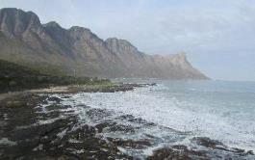
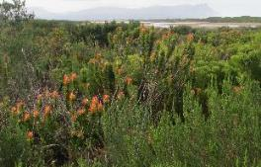
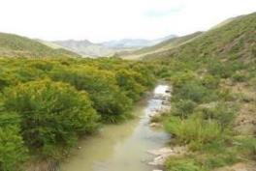
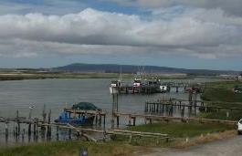
ADDITIONAL SLIDES

Slide 76
The Study Team
Expert Reviewers:
Prof André Görgens
Willie Enright
Dana Grobler
Aurecon
(integration & study management)
Team Leader: Erik van der Berg
Freshwater Ecology
(Southern Waters)
Dr Cate Brown and Dr Karl Reinecke
Surface Water Hydrology & Dams
(Aurecon)
Prof André Görgens
Erik van der Berg
Stakeholder Engagement
(Milkwood Communication)
Bea Whittaker
Estuaries
(Anchor Environmental)
Dr Barry Clark
Water Quality
(Aurecon)
Nico Rossouw
Social & Economic
(Anchor Environmental)
Dr Jane Turpie
Wetlands
(Aurecon)
Louise Lodenkemper
Groundwater
(Delta-H) Dr Helen Seyler

Slide 77
Integrated Units of Analysis
Socio-economic Zone | Zone Code | River Resource Unit | IUA Name | IUA Code
Upper and Middle Breede | A | Upper Breede Tributaries | Upper Breede Tributaries | A1
 |  | Breede Working | Breede Working Tributaries | A2
 |  | Middle Breede Renosterveld | Middle Breede Renosterveld | A3
Upper Riversonderend and Palmiet | B | Riviersonderend Upper | Riviersonderend Theewaters | B4
 |  | Overberg West (part 1 of 3) | Overberg West | B5
Great Karoo | C | Groot/Touws (part 1 of 2) | Gamka-Buffels | C6
 |  | Gamka (part 1 of 2)
Little Karoo West | D | Lower Gouritz (part 1 of 2) | Gouritz-Olifants | D7
 |  | Olifants
Little Karoo East | E | Groot/Touws (part 2 of 2) | Touws | E8
Wheat belt | F | Riviersonderend Lower | Lower Riviersonderend | F9
 |  | Overberg West (part 2 of 3) | Overberg East Renosterveld | F10
 |  | Overberg East Renosterveld (part 1 of 2)
 |  | Lower Breede Renosterveld | Lower Breede Renosterveld | F11
 |  | Duiwenhoks (1 of 2) | Duiwenhoks | F12
Garden Route coast | G | Coastal Rivers (1 of 2) | Groot Brak | G14
 |  | Coastal Rivers (2 of 2) | Coastal | G15
Overberg coast | H | Overberg West (3 of 3) | Overberg West Coastal | H16
 |  | Overberg East (Fynbos) | Overberg East Fynbos | H17
Hessequa coast | I | Duiwenhoks (2 of 2) | Hessequa | I18

